Slide 1
Some WTF?!? moments
A powerpoint by
Lola Daisy May Taylor.
Not.
(It’s uberdumb)

Slide 2
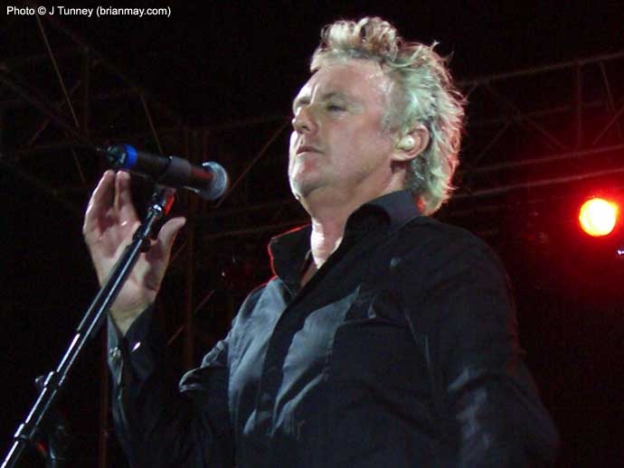
WTF?!?!

Slide 3
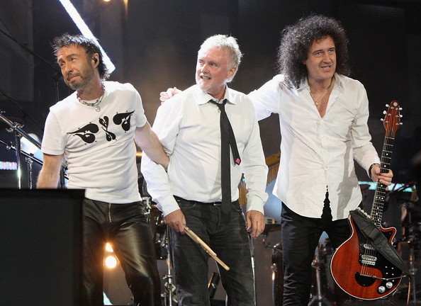
I’m gay!
WTF?
Who’s idea was it to hire him?
Never mind, Roger. Just pretend he’s not there.

Slide 4
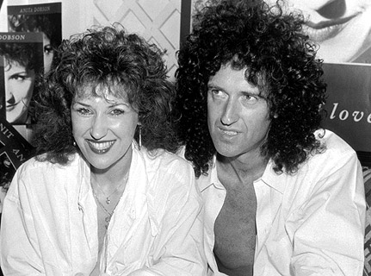
WTF?!? Why am I surrounded by ANITA STUFF?!?!

Slide 5
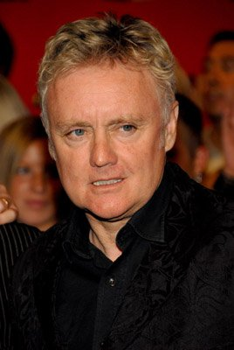
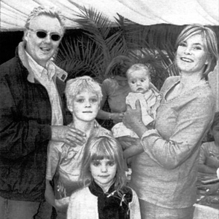
WTF?
Are those incredibly mental children mine?
WTF?
I hope I’m not related to that ugly thing!

Slide 6
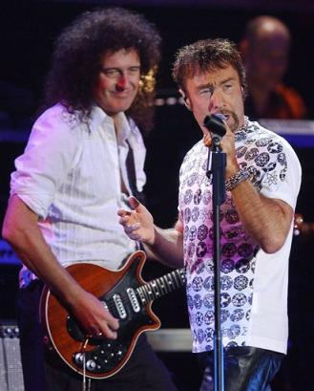
BECAUSE YOU SUCK, obviously!
WTF? Why is everybody booing me?

Slide 7
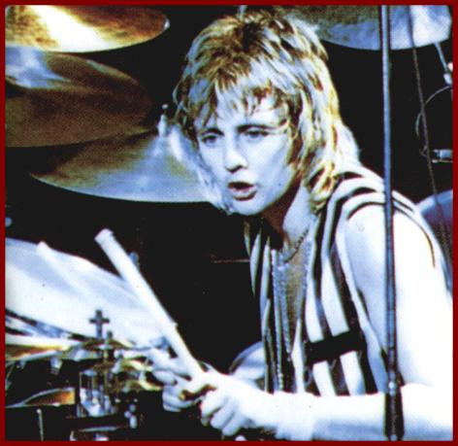
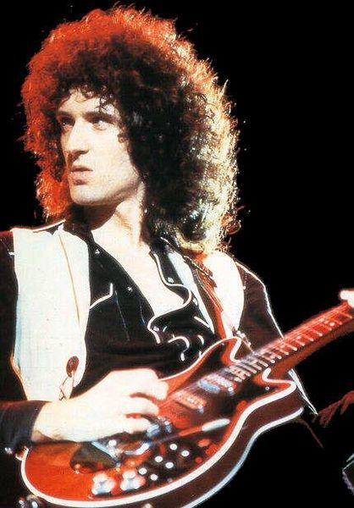
!
COOKIES!
WTF?

Slide 8
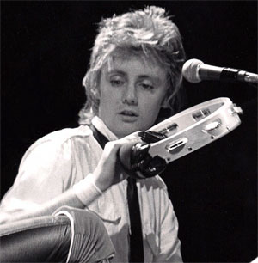
WTF? Where’d that come from?

