Slide 1
Queen in 1982
Why? Because the pictures are überclear, übergood, and because Queen is überawesome.
Guaranteed to make you laugh if you think Roger or anyone else looks funny, or no money back since you never paid in the first place.

Slide 2
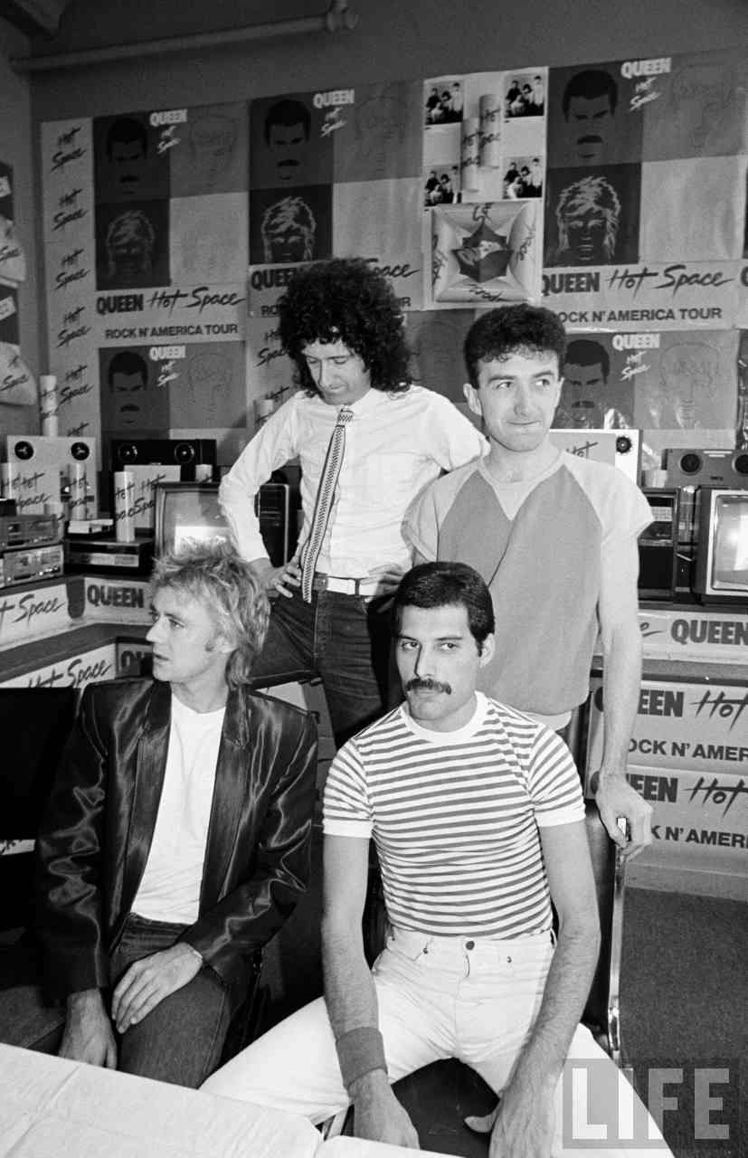
This is the moment when none of them want to look at the camera.

Slide 3
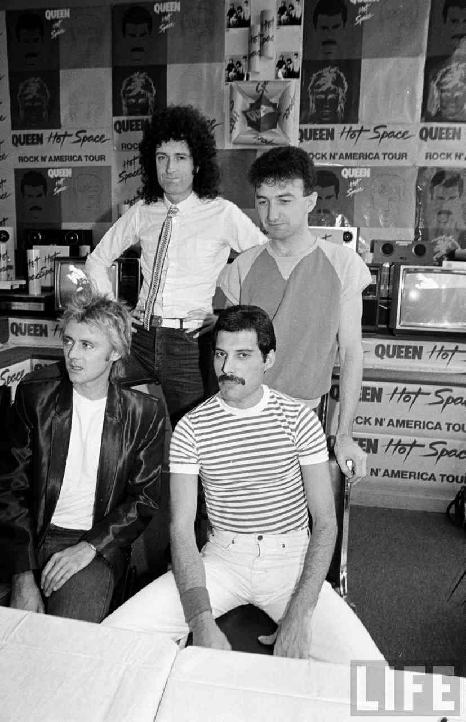
This is the moment when Brian and Freddie decide to stare-down Mr. Camera man

Slide 4
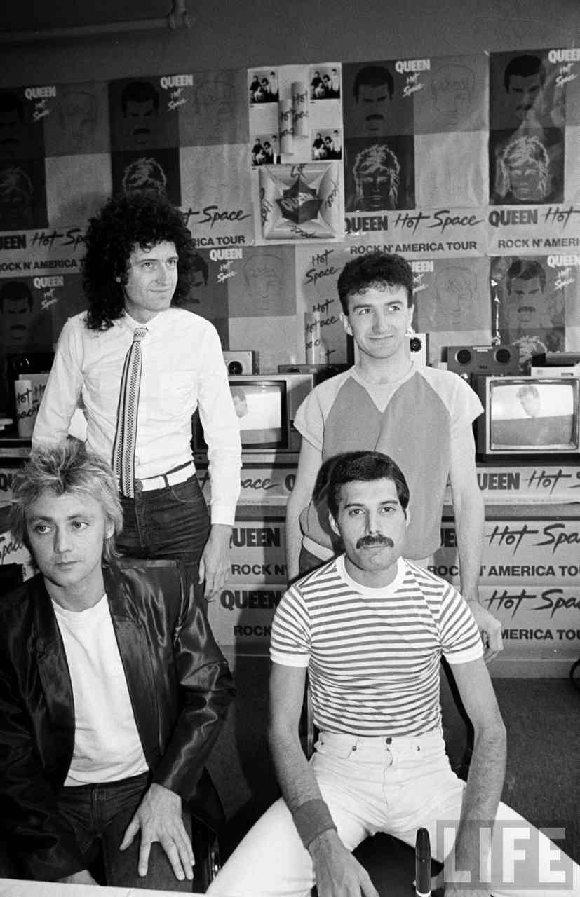
This is the moment when Brian decided to stare at someone else all creepy like.

Slide 5
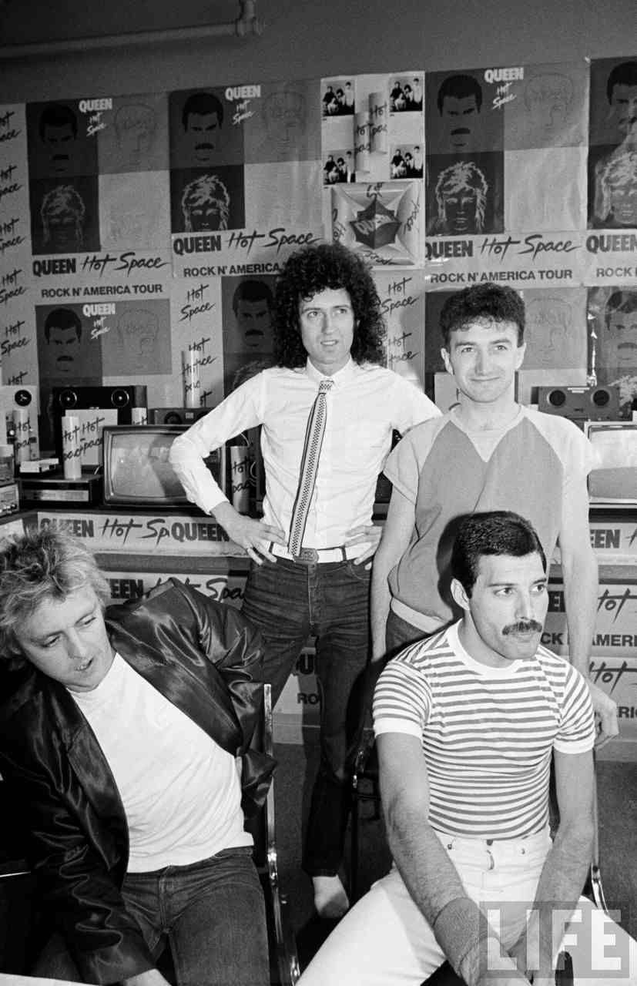
This is the moment when Roger starts to act ubermental(ler). And John’s happy.

Slide 6
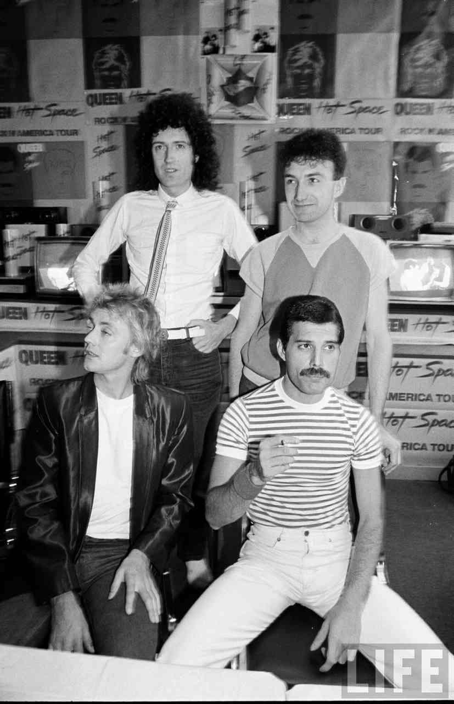
This is the moment when Freddie wants to point something out, and Roger thinks he is hallucinating from seeing all this Hot Space stuff, when many people don’t even like the album all that much.

Slide 7
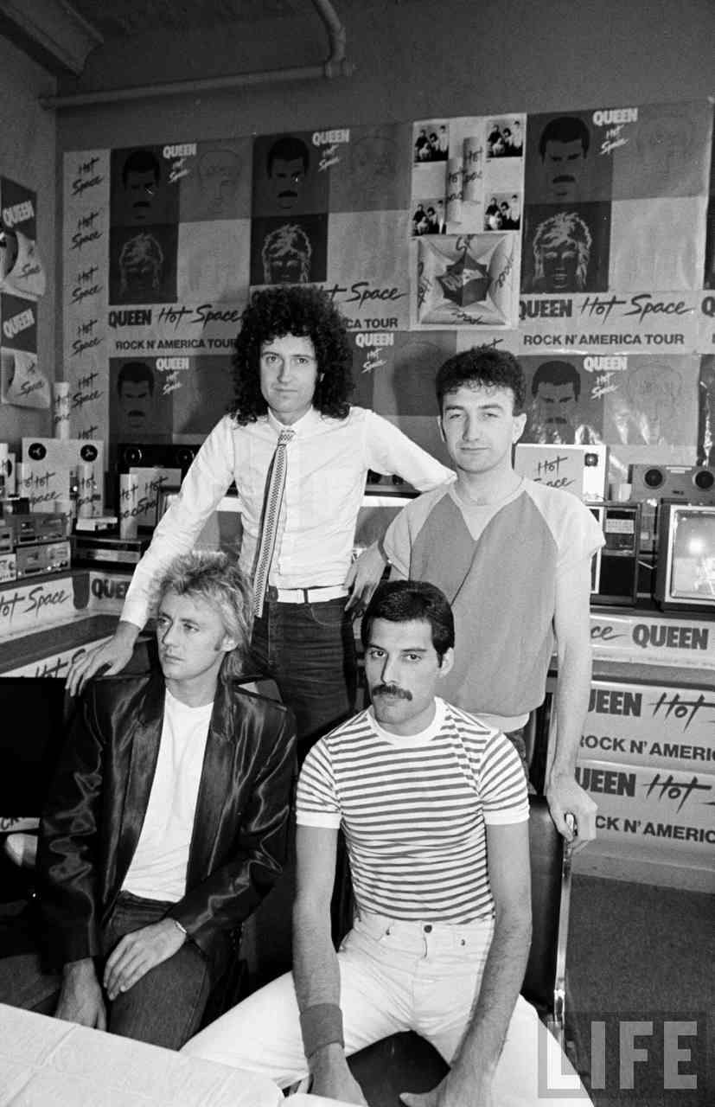
This is the moment when they are all starting to get bored or pissed off.

Slide 8
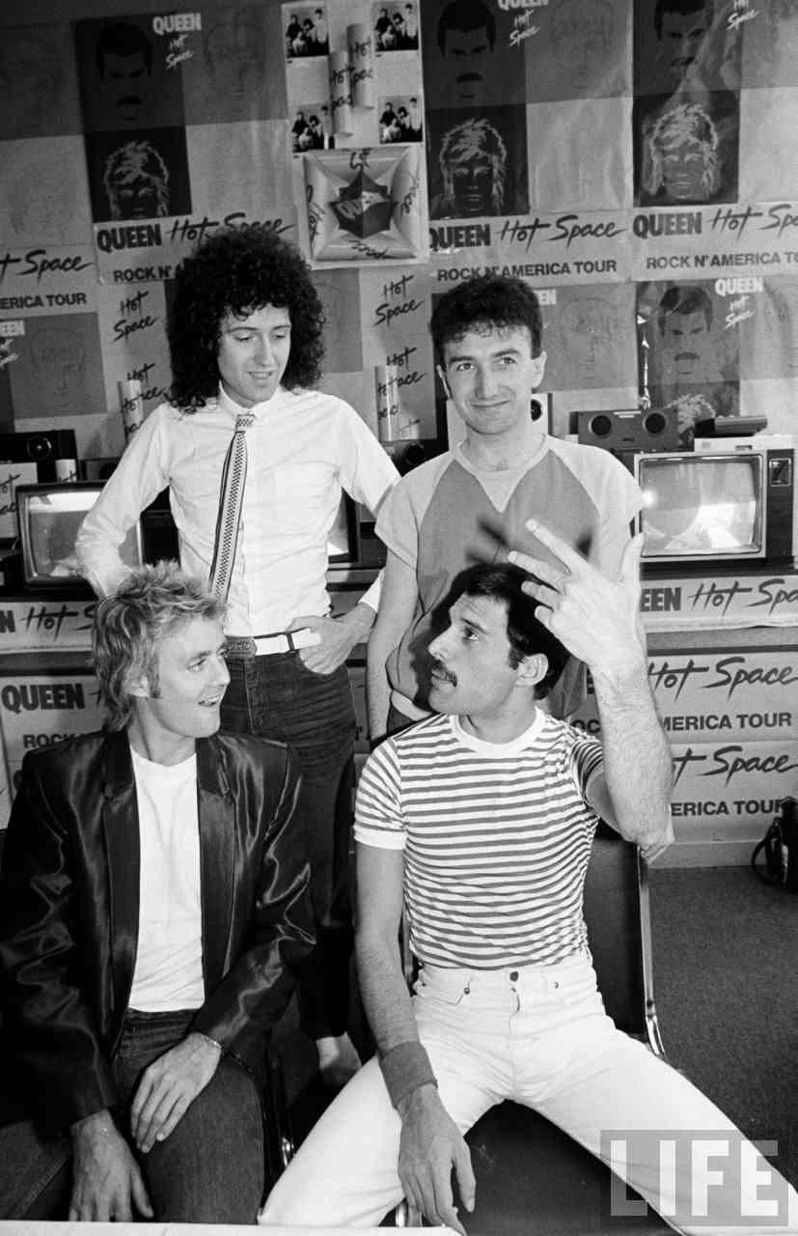
This is the moment where Roger realizes that you can look behind you. He’s amazed

Slide 9
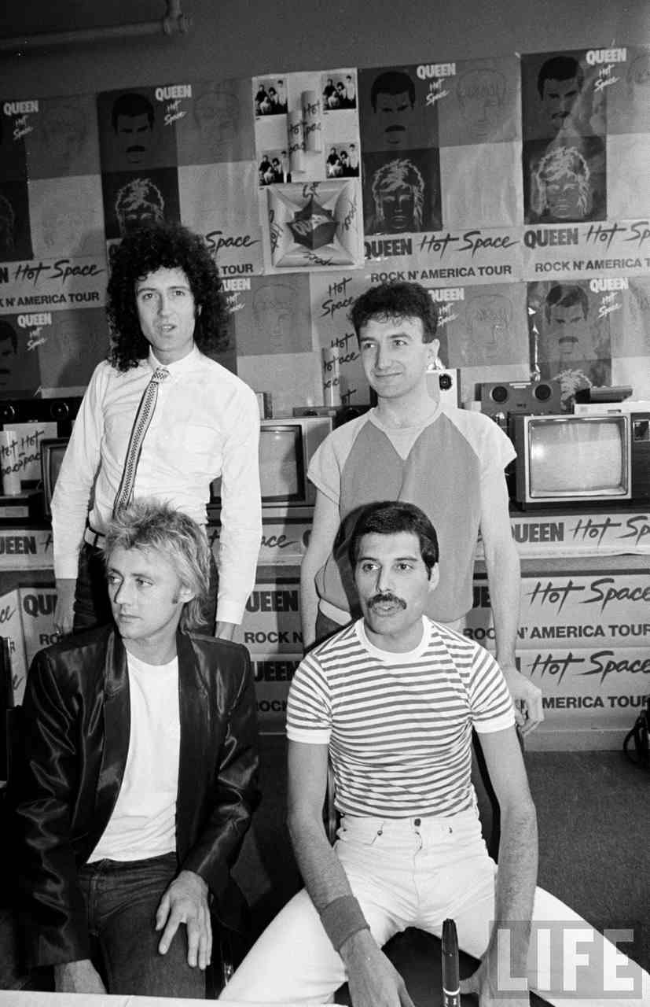
This is the moment when Brian has a dumb moment, Freddie starts to say “Oh do fuck off” and John & Roger see something they kinda like if you know what I mean….. They see freshly baked cookies!

Slide 10
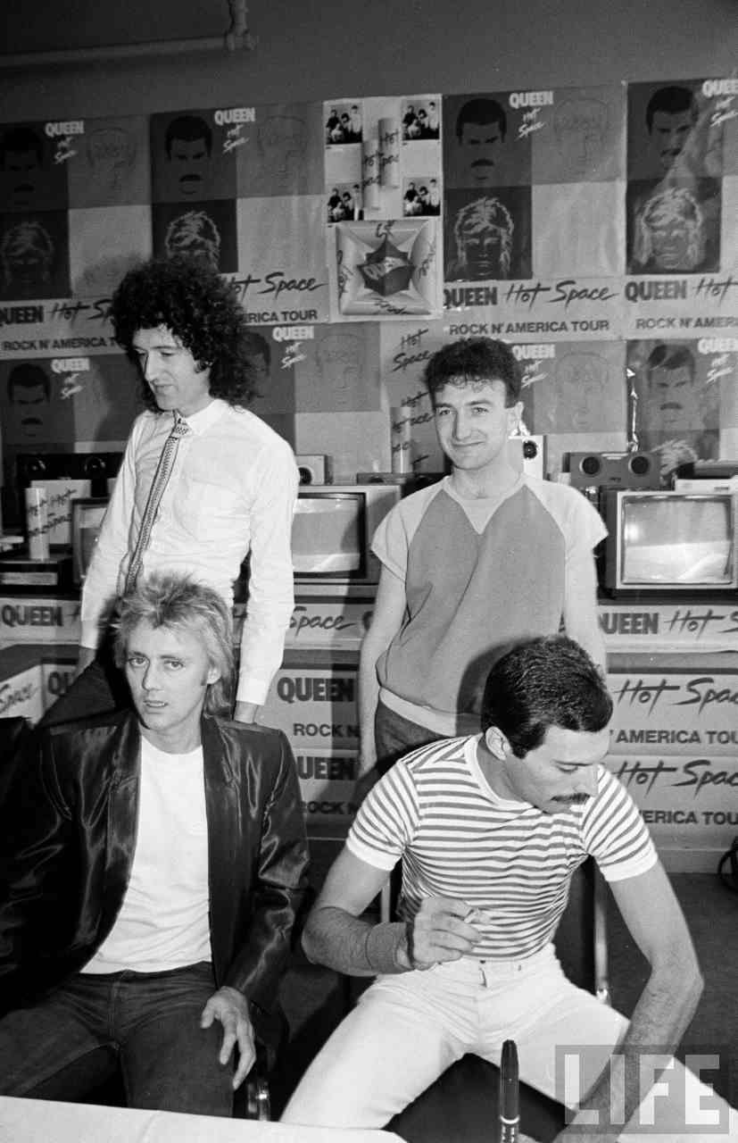
This is the moment where Roger realizes where the camera is, and Brian tries to make a break for it.

Slide 11
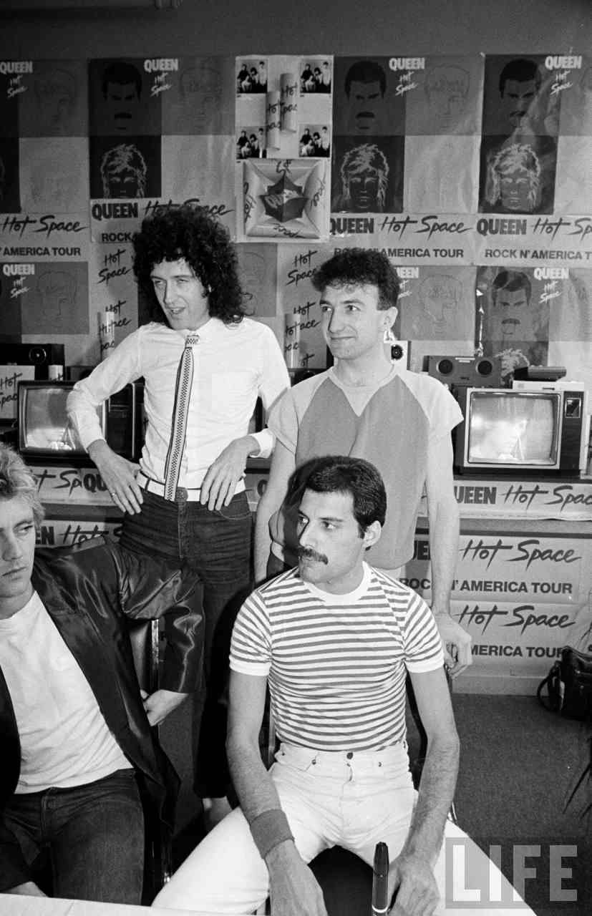
This is the moment where Roger and Freddie realize their love for each other. JUST KIDDING. They realized that they are both mental.

Slide 12
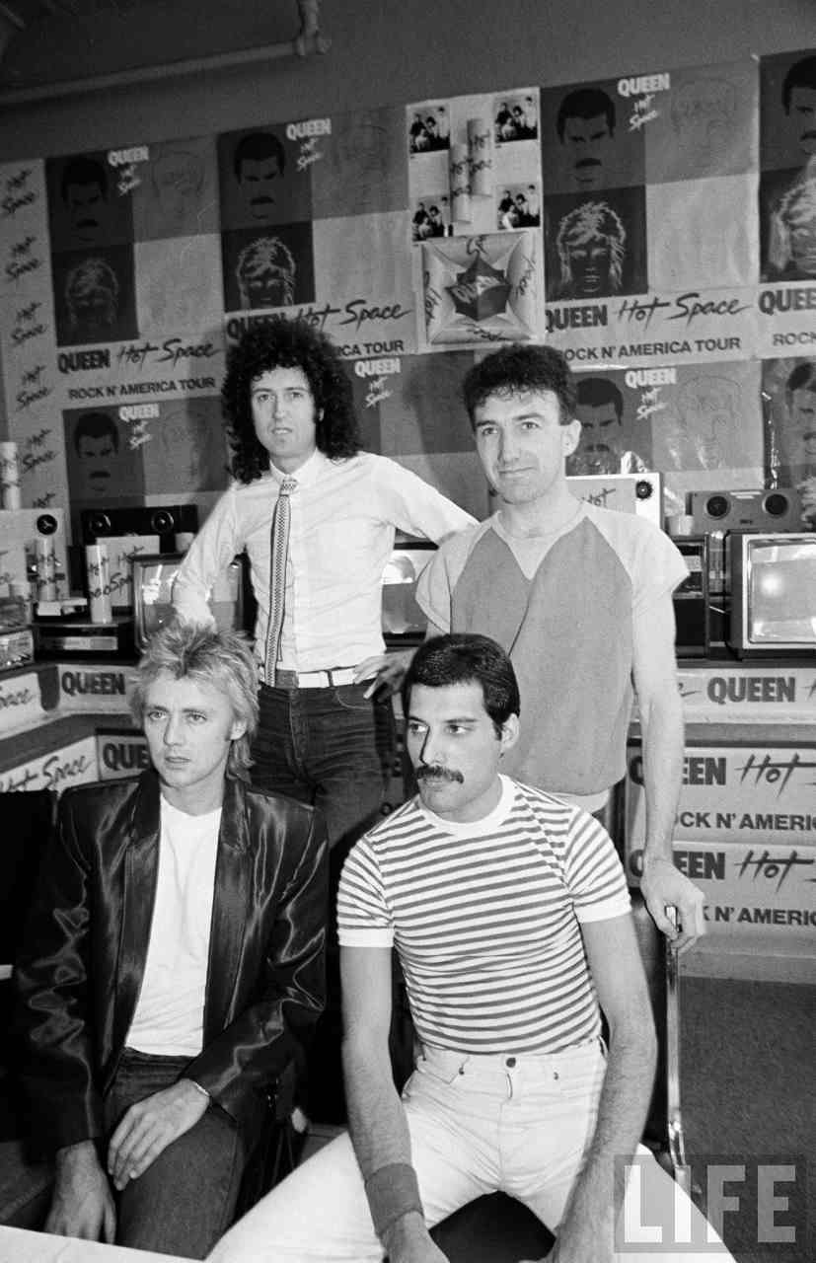
This is the moment when they wished they could be done with this.

Slide 13
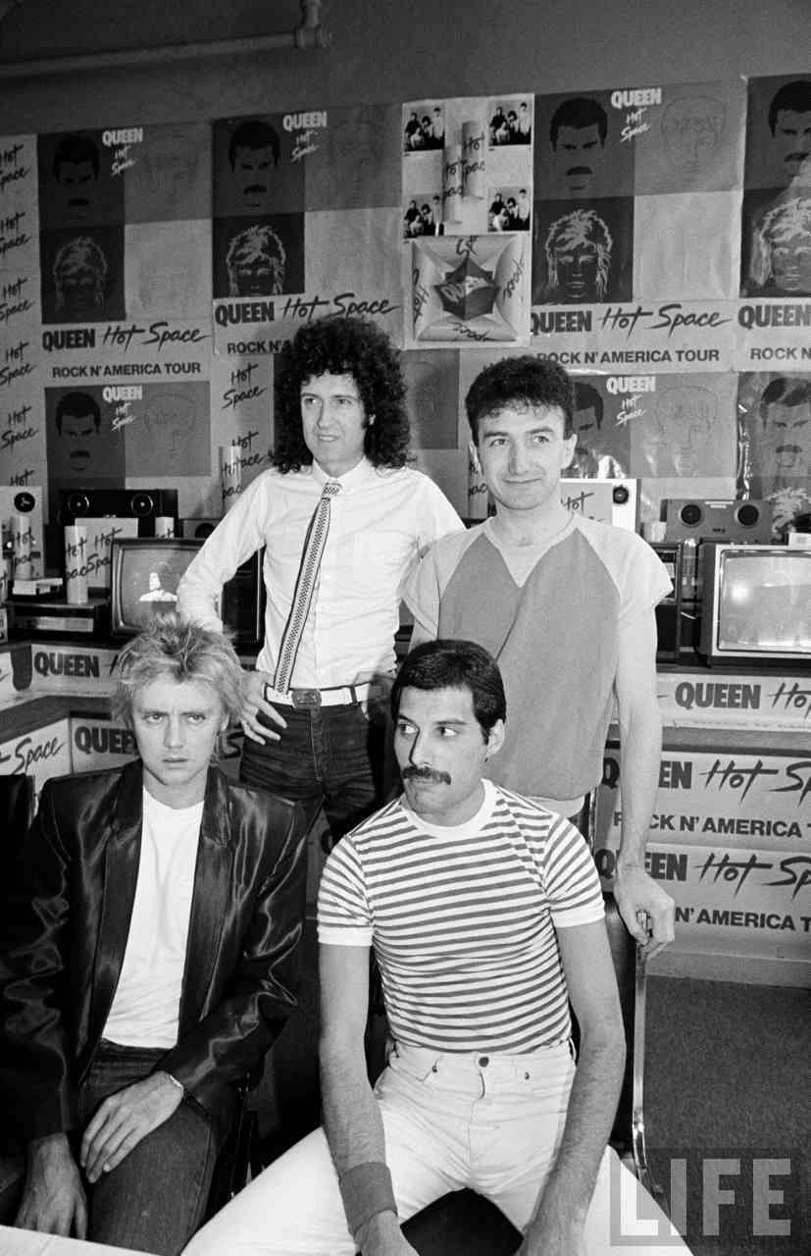
This is the moment when Roger finds out they can’t be done with this, and becomes ÜBERANGRY!

Slide 14
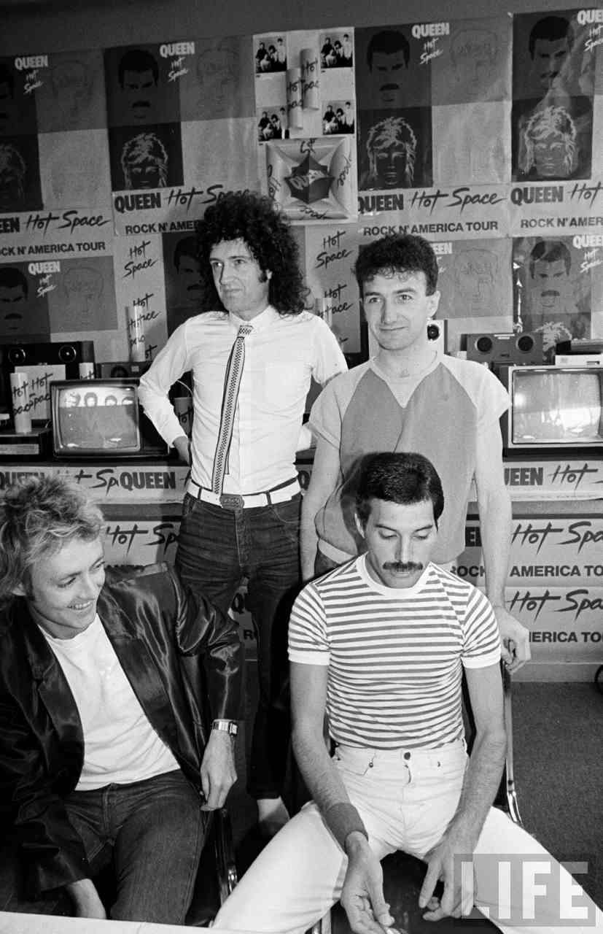
This is the moment when Freddie doesn’t want to relive the moment where Roger almost killed him (by throwing his whole bloody drumset across the stage) so he makes simple-minded Roger happy by telling a joke. Brian doesn’t get it.

Slide 15
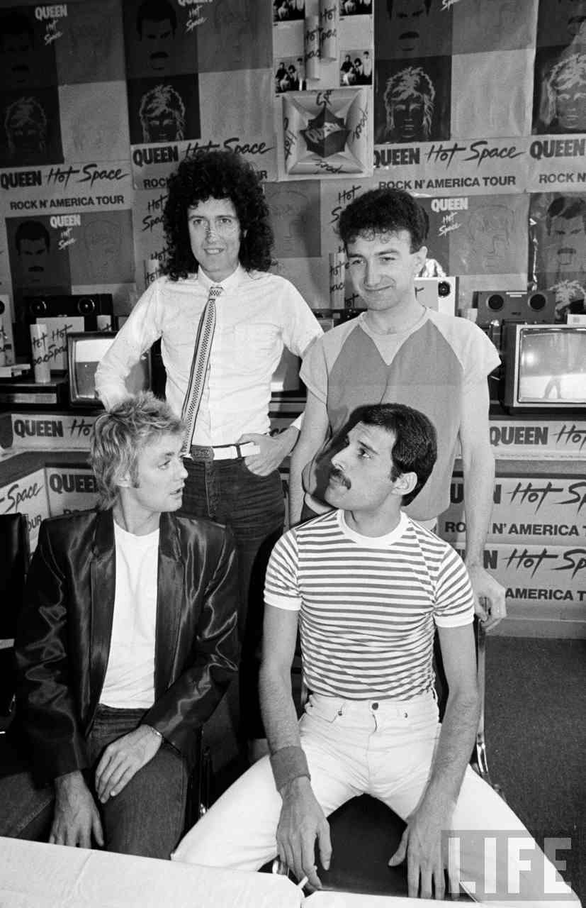
This is the moment when Freddie explains the joke to Brian, who thinks the joke is clever, John laughs at Brian, and Roger doesn’t get the joke anymore.

Slide 16
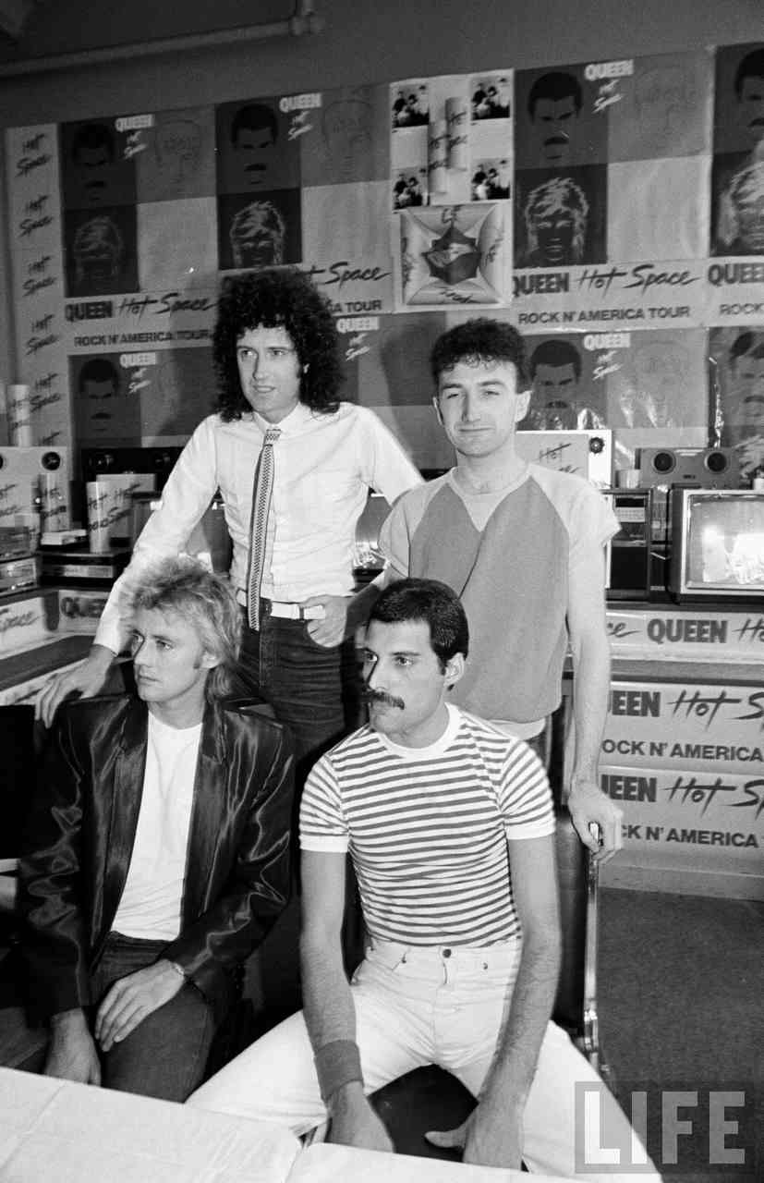
This is the moment when there is an awkward moment, and John enjoying the sweet aroma coming from the cookies.

Slide 17
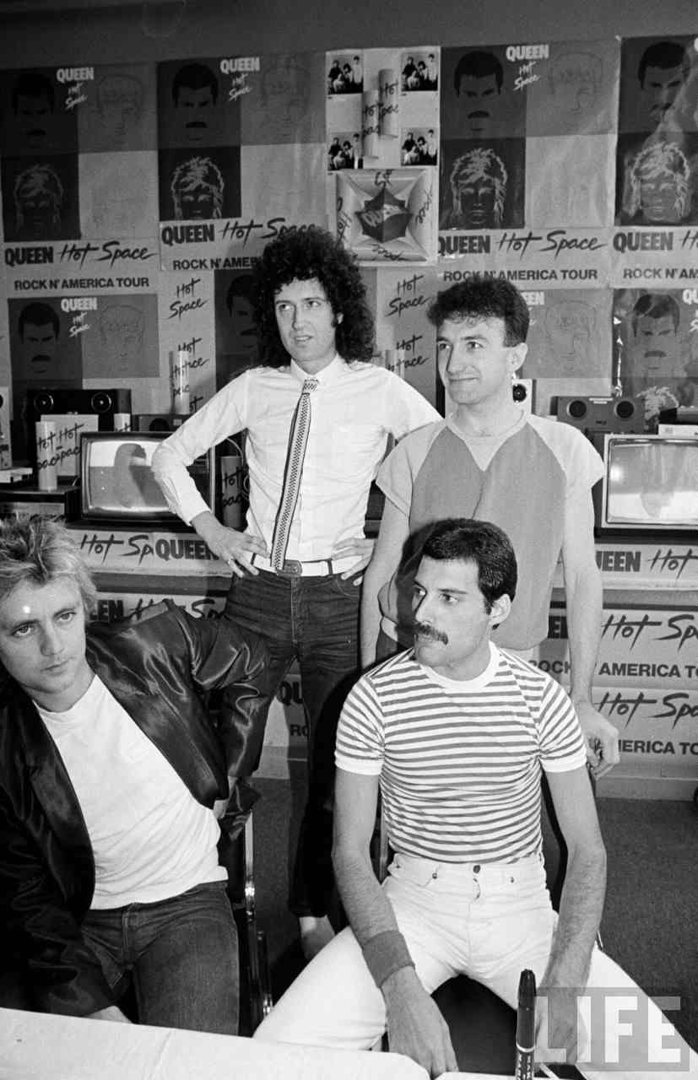
This is the moment where Roger becomes angry because he finds out there’s a white dot above his right eye. Freddie thinks he’s mental still.

Slide 18
The End

