Slide 1
Queen in 1982
Why? Because the pictures are überclear, übergood, and because Queen is überawesome.
Guaranteed to make you laugh if you think Roger or anyone else looks funny, or no money back since you never paid in the first place.
With comments to make it awesomer.

Slide 2
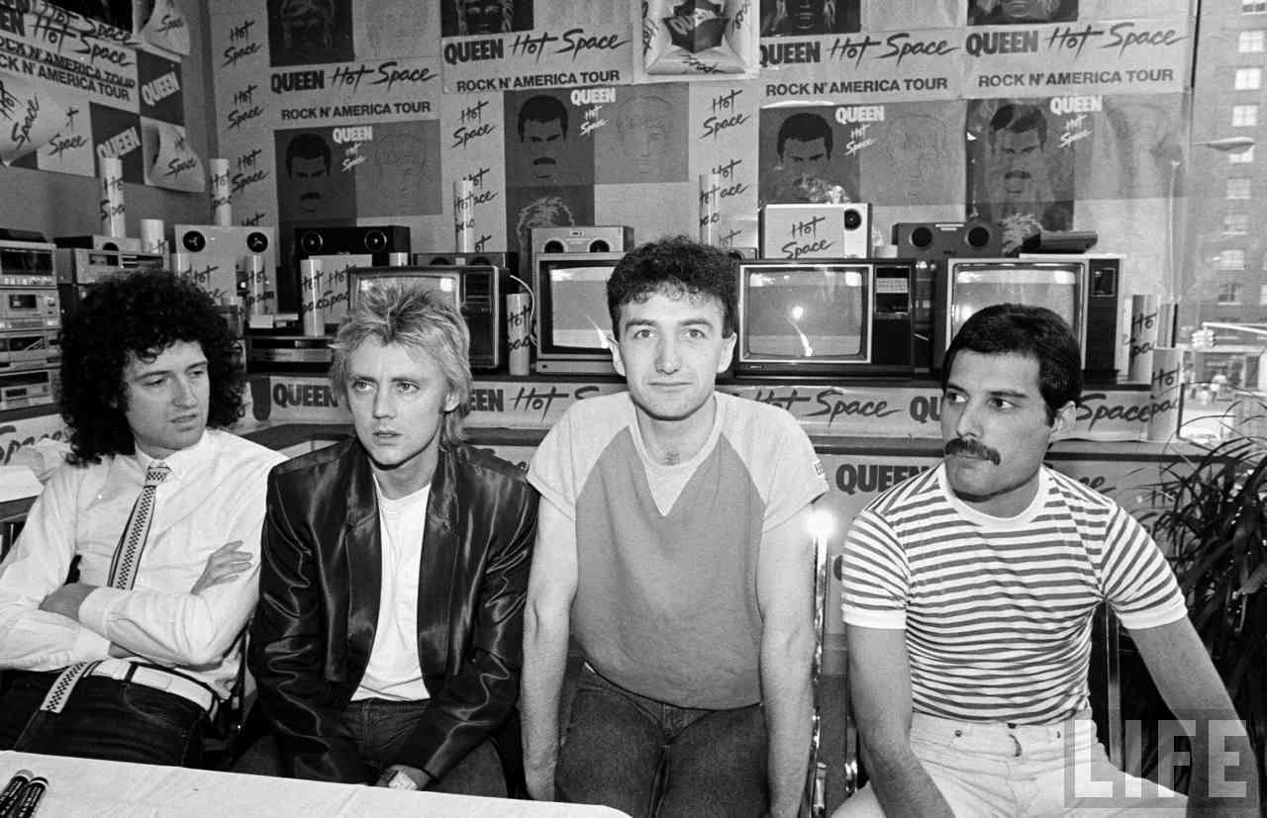
Brian and Roger are very mad at each other. Roger can’t even look at Brian (Brian of course is still looking at Roger.
John is amazed at how many Hot Space pictures/banners/etc. there are when many people didn’t even like the album!

Slide 3
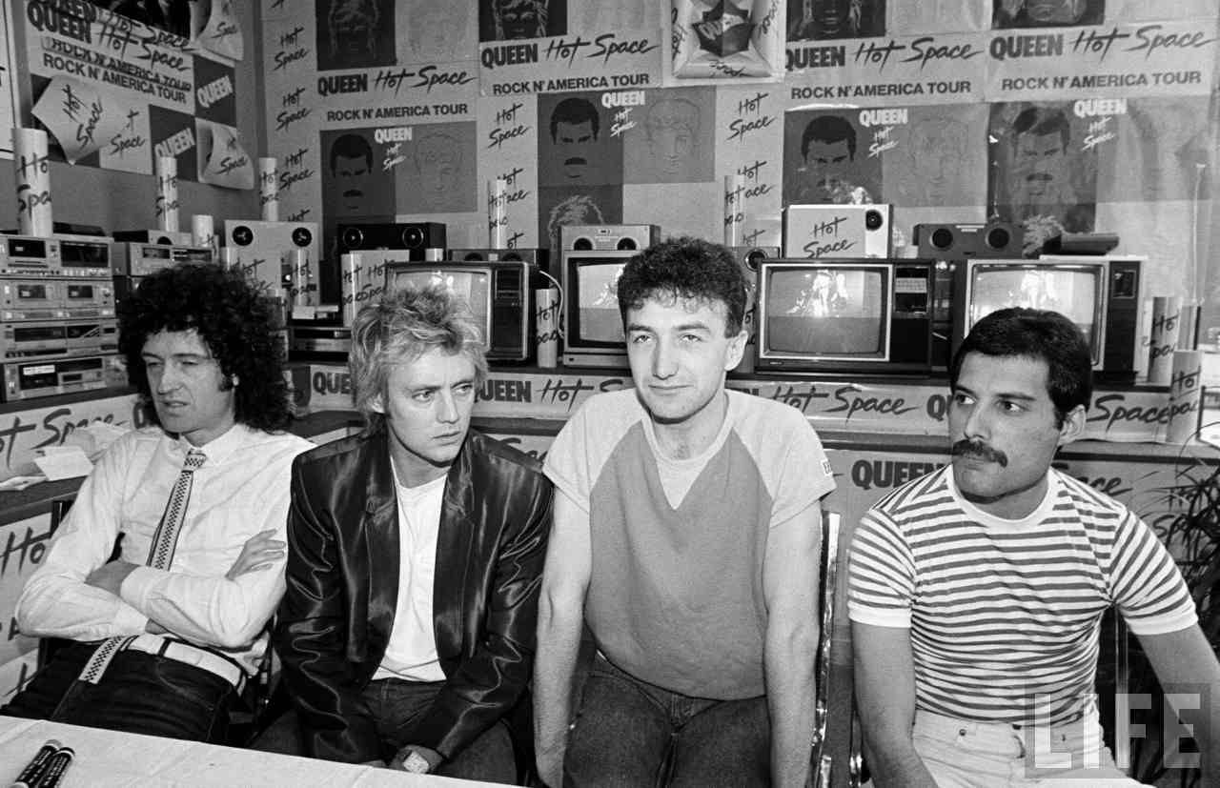
Roger (somehow) just figured out that someone put some kind of drug in Brian and John’s tea!

Slide 4
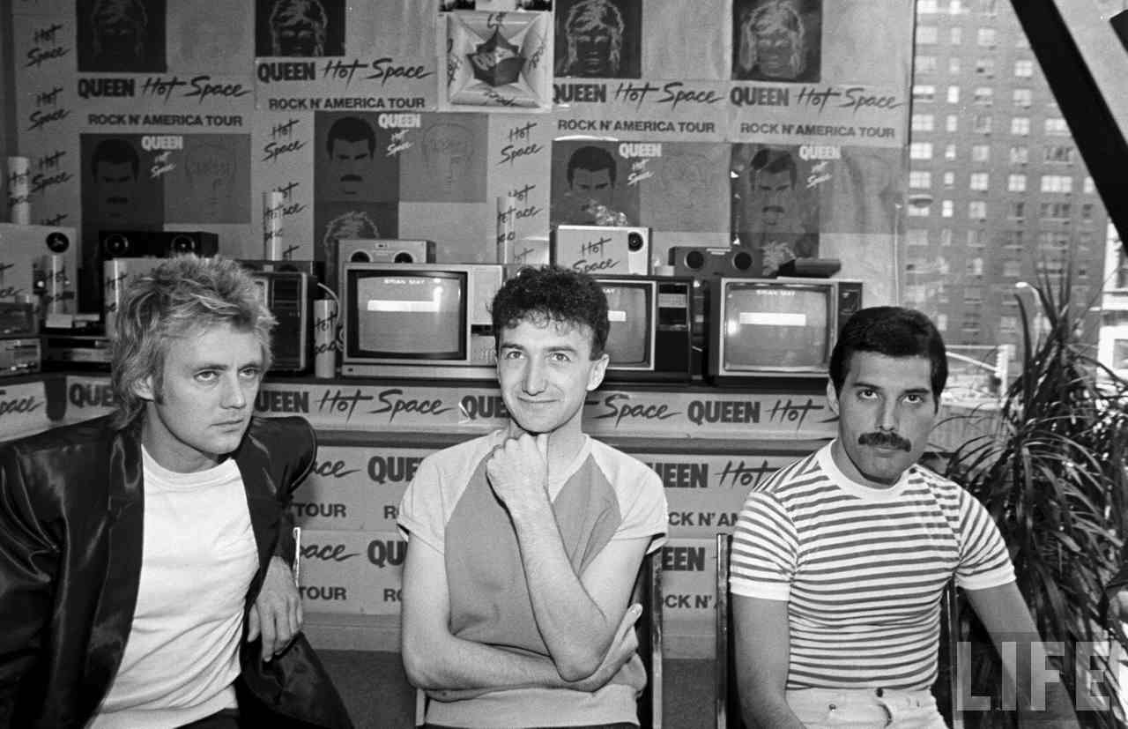
Brian’s done with this. Roger’s trying to see his eyebrows. John’s thinking about all the nice vacation spots he could be at right now. Freddie is… doing stuff. Awesome Freddie stuff.

Slide 5
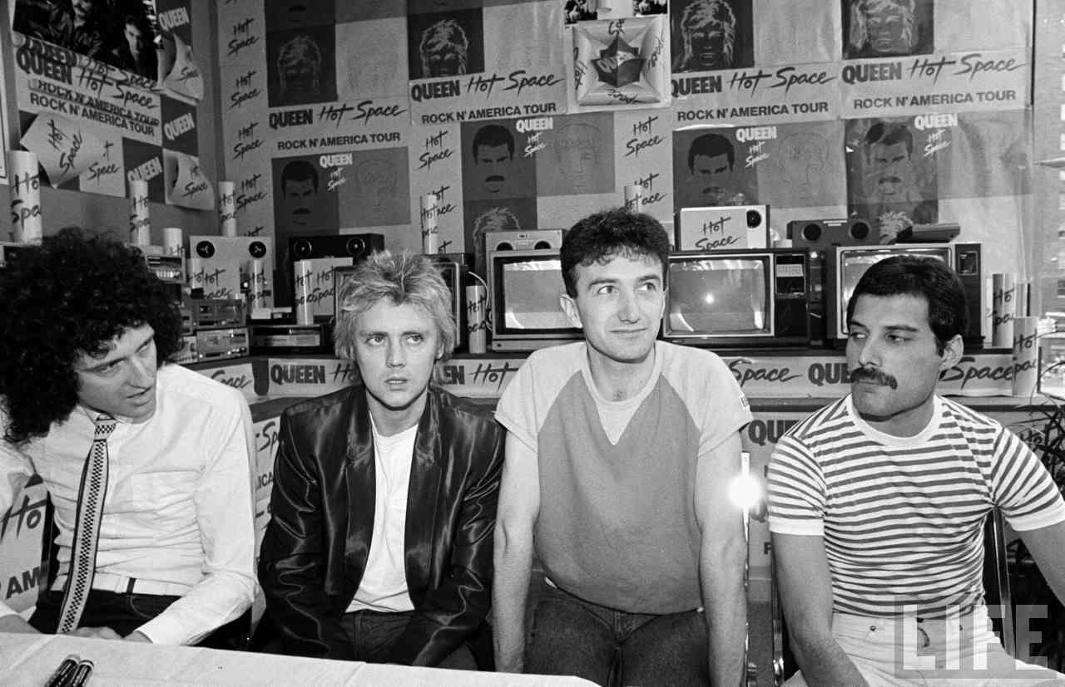
Brian and Freddie are having a staring contest. I think Brian will win.
Roger and John are looking at something. Possibly an awesome something.

Slide 6
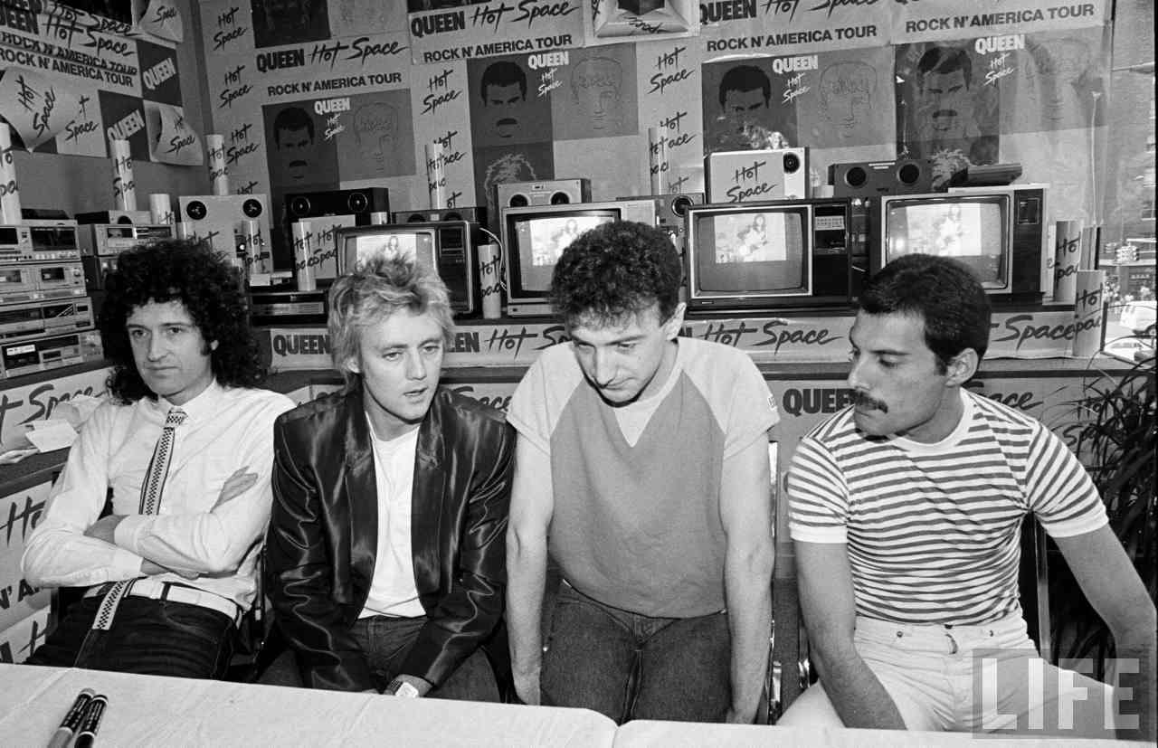
Brian’s angry. He lost the staring contest. Roger’s having a blonde moment. John’s trying to use his awesomeness to make tea appear on the table. And Freddie is looking at… something. Maybe Roger’s watch.

Slide 8
The End

