Slide 1
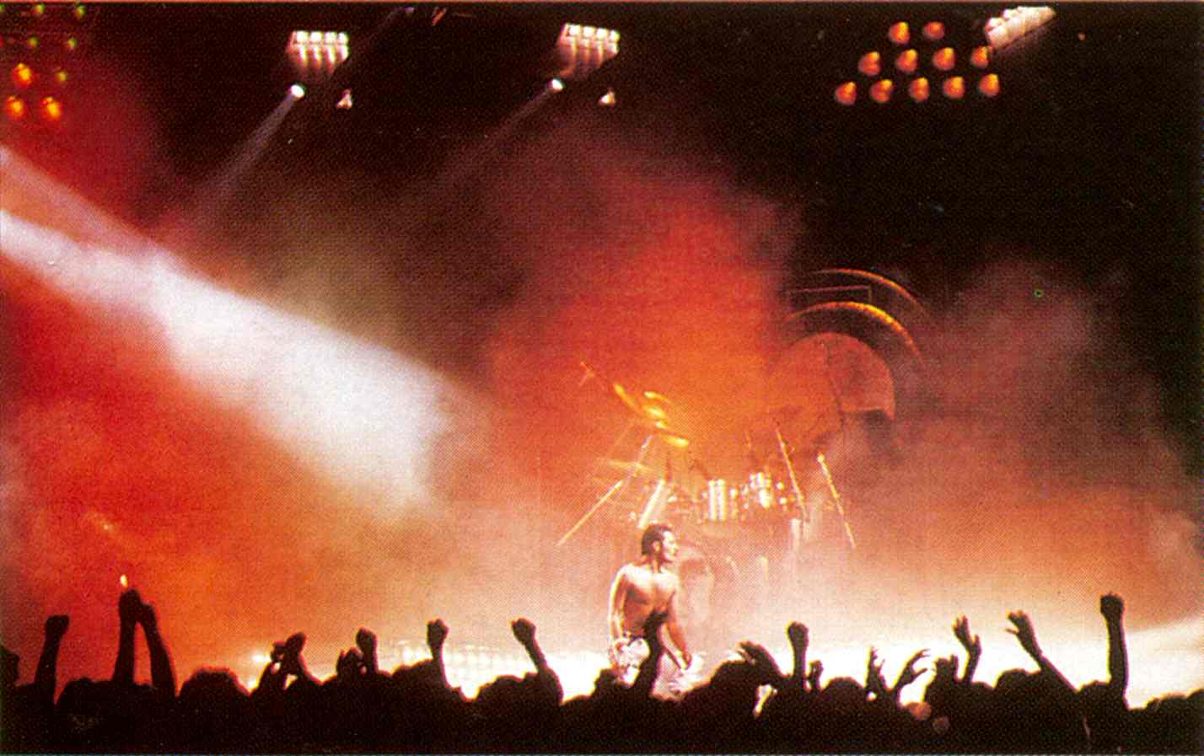
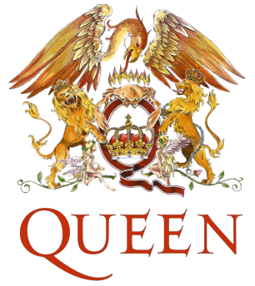
Queen
This PowerPoint is full of Queen info that you may or may not know, as well as pictures you may or may have not seen. You will find this PowerPoint interesting unless you could care less about Queen (which means you’re dumb, just kidding. or not…) or unless you already know everything about Queen and the individual members, which, even if you’re an überfan, is unlikely.
The world’s greatest band
(whether you know it or not)

Slide 2
Queen was formed in 1970 by Brian May, Roger (Meddows) Taylor and Farrokh “Freddie” Bulsara, who later changed his name to ‘Freddie Mercury’, who he is known as today. It wasn’t until 1971, after many other bassists that the last Queen member, John “Deaky” Deacon, joined.
It was a bit of a slow start for Queen. In 1973 they released their first album, a self-titled one, but it received little attention and had poor sales, though it did get good feedback from critics. Their first single ‘Keep Yourself Alive’, written by May, also sold poorly. Queen became known as “one of the most underrated rock debuts of all time.”
Things began to get better for the group after they released their second album Queen II in 1974. Their second single ‘Seven Seas of Rhye, written by Mercury, became their first hit reaching 10 in the UK. During this time they did their first tour as support to Mott the Hoople, and they began to get noticed. But record sales were still low.
Later that same year their third album Sheer Heart Attack was released, though May was mostly absent when it was started because he was suffering from Hepatitis. It did much better than the first two albums, reaching number 2 in the UK, sold well through Europe, and went gold in the US. It gave the band their first taste of success. It was a unique album, as were all of Queen’s albums, experimenting with many different genres. Queen became known for this, having all four of the members contributing at least one song per album (except for the first 2, where Deacon didn’t contribute).
After they completed their Japan tour in 1975, they began working on their next album, A Night at the Opera. At the time, it was the most expensive album ever created. Once again, this album explored the different music styles of Queen. The album was very successful. The single that everyone will of heard at least once, “Bohemian Rhapsody”, written by Freddie Mercury, was a huge hit and may very well be the best song ever, as it has been voted that many times. For this song, Queen decided to make their first “true” music video for it. “Bohemian Rhapsody” was the first music video to be offered for free to any station, network, or program that would air it. The second single from the album, “You’re My Best Friend”, written by John Deacon, was also successful.
By 1976, Queen was back in the studio recording A Day at the Races which is often mistaken for A Night at the Opera, as their covers are similar and they are both named after Marx Brothers’ movies. The album was successful, as were the two main singles released from is: “Somebody to Love”, written by Mercury, and “Tie Your Mother Down”, written by May.
In the year of 1977, Queen released News of the World. In it, it had some very good songs, the most recognizable being “We Will Rock You” (May) and “We Are the Champions” (Mercury), which from then on were played at nearly every live show. The two singles also became international sports anthems, and are heard nearly anywhere. Also during this year, Roger began working on some solo work.
A year later they released their seventh album, titled Jazz. The album included the hits “Bicycle Race” (Mercury) and “Fat Bottomed Girls” (May). The album was not a jazzy album, so don’t be mistaken by the name. In 1979 they released their first live albums, Live Killers.

Slide 3
1980 was the year where they released the successful album The Game, which was also the first album of Queen’s to have synthesizers. On The Game, the singles released were: “Another One Bites the Dust” (Deacon), “Crazy Little Thing Called Love” (Mercury), as well as “Save Me” (May) and “Play the Game” (Mercury). Later that year they released the soundtrack for the movie Flash Gordon.
In 1981, Queen didn’t release an album, but they did lots of touring, and worked with David Bowie on a song that was later called “Under Pressure”. Later that year, Queen released their first greatest hits album. It was highly successful, and as of 2007, is the UK’s best selling album. Also Roger Taylor became the first Queen member to release a solo album, called Fun In Space, though it did not do to well.
During the year 1982, Queen released the album Hot Space, which some people called it the worst Queen album and it was hated by Queen’s own Roger Taylor (with an exception of the track “Under Pressure”).
Finally in 1984, after a year off from touring, Queen released The Works. On this album, it had the first Queen single written by Roger Taylor, called “Radio Ga-Ga”, which went on to be a hit. Before this, his songs were deeply underrated. The album, though only 9 tracks long had 4 singles: “Radio Ga-Ga” (Taylor), “It’s a Hard Life” (Mercury), “I Want to Break Free” (Deacon) and “Hammer to Fall” (May), one song from each member.
In the year following 1984, Queen toured some more, their most notable concerts being the ‘Rock in Rio’ festival. It was a two night festival, and each night they performed in front of over 180 000 people.
At Live Aid, held on July 13th 1985, Queen as well as many other successful groups performed. They performed some of their greatest hits, and it has become known as one of Queen’s best performances to date, which is really saying something became Queen always, delivers a great show. Following their Live Aid performance, Queen’s record sales continued to go up, and they ended 1985 by releasing the single “One Vision” which was used in the movie Iron Eagle. They also released a limited-edition boxed set, The Complete Works, which contained hits as well as previously unreleased material.
In early 1986, Queen began recording the album A Kind of Magic, containing several songs to be used in the movie Highlander. The album was very successful, producing a string of hits, including the title track “A Kind of Magic” (Taylor) which contained key lyrics such as “There can only be one”, making reference to the movie’s plot.
Later that year, Queen went on a sold out tour (the band’s largest) in support of the A Kind of Magic album. The most notable concert was at Wembley, as there is a CD and DVD collection for the concerts. They couldn’t book Wembley the third night, so instead played at Knebworth Park, which was sold-out in about two hours. Unfortunately, this was Queen’s last live performance with Mercury. The tour set a record (at the time) for having the most people come to watch the shows.
Three years later, they released The Miracle. This album was very successful, as it contained hits such as: “The Miracle” (Queen), “I Want it All” (May), “The Invisible Man” (Taylor), “Breakthru” (Taylor), and “Scandal” (May).

Slide 4
After fans noticed Mercury’s thin appearance in 1988, rumours began flying that Mercury had AIDS. For reasons unknown and will stay that way, Mercury denied it, and insisted he was too tired to do interviews. However, Queen continued to put out albums.
In 1990, they began working on Innuendo, but it was not released until 1991, because of Mercury’s deteriorating health. The album had singles which were “These Are the Days of Our Lives” (Taylor), “I’m Going Slightly Mad” (Queen), “Innuendo” (Taylor), “The Show Must Go On” and “Headlong” which there was a video for all of them, “These Are the Days of Our Lives” being Queen’s final video with Mercury.
On November 23 1991, Freddie Mercury made a statement (made on his deathbed) confirming that he did in fact had AIDS. Within 12 hours of that statement, Freddie died of bronchial pneumonia, which was brought on by AIDS. His funeral service was private and consisted of Freddie’s family, and the remaining members of Queen and their wives.
Shortly after Mercury’s death, “Bohemian Rhapsody” was re-released as a single, with “These Are the Days of Our Lives” as the B-side. The single went to number one. The song was also in 1992’s Wayne’s World.
On April 20th 1992, the Freddie Mercury Tribute concert was held at London’s Wembley stadium, it had many performers, three of which were the remaining members of Queen. It was a successful concert that was televised to over 1 billion viewers worldwide. The concert is listed in ‘The Guinness Book of Records’ as "The largest rock star benefit concert." It raised over £20,000,000 for AIDS charities.
Many fans also paid their respects by leaving gifts and what-not outside of Freddie’s house, which became Mary Austin’s house. Later a statue of Freddie was made in Montreux, overlooking a lake, as seen on the cover of Made in Heaven.
Made in Heaven was released in 1995 using material scrapped earlier on in Queen’s career, songs that Freddie recorded in his final days, and some other songs such as Freddie’s solo stuff. After it was released, John Deacon decided to retire from music, Roger Taylor worked on some more solo stuff as well as his side-band The Cross (which later broke-up), and Brian May worked on solo work.
Several Queen + projects were developed in the following years. Brian May and Roger Taylor preformed as Queen on several occasions, with guest singers on lead vocals. At the end of 2004, May and Taylor announced that they would reunite and return to touring in 2005, as Queen + Paul Rodgers. Many people did not like this, thinking that the idea was to replace the irreplaceable Freddie Mercury, and that if they wanted to work together fine, but don’t call yourself ‘Queen’ even if it’s ‘+ (somebody)’. John Deacon did not come back to “Queen” either. They went on to release albums such as “Return of the Champions’ and ‘The Cosmos Rocks’, which weren’t even close to the sales of the actual Queen albums.
Even though Queen (as just Queen) ended after the release of Made in Heaven, they still have many fans, and keep getting more and more. If you still don’t know who Queen is, remember this: Queen is one of the most successful bands in the history of music, and they rock.

Slide 5
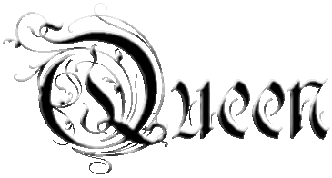
They have performed in nearly every country in the world (according to Roger, “everywhere with the exception of Russia… we’re banned there”)
The Flash Gordon soundtrack they did, was probably the first rock soundtrack for a movie, and many didn’t think it would work. It was considered to be a huge flop, but you have to remember, it was made in 1980.
Originally, Brian and Roger agreed on calling the new band “Grand Dance” (a phrase from the C.S. Lewis trilogy Out of the Silent Planet). Obviously, it did not end up being called that.
For the Queen II cover pictures, Brian is at the back but if Roger had had Brian’s hair (as in thick and wavy, and of course big) and Brian had Roger’s (as in thinner and straighter), they’d be in opposite places.

Slide 6
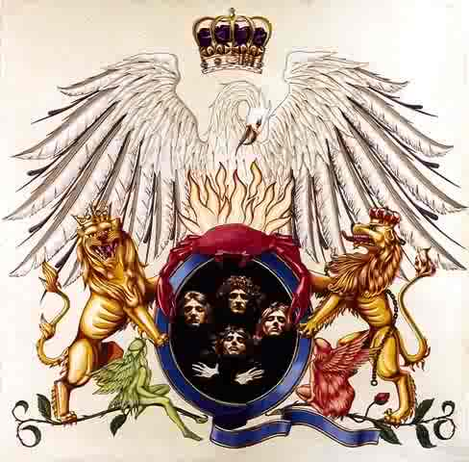
The Logo
The Queen logo, also known as the Queen crest, was designed by Freddie Mercury (who earned a degree in Illustration and Graphic Design) shortly before the release of their first album. The logo features the zodiac signs of all four members: two lions for Leo (Taylor and Deacon), a crab for Cancer (May), and two fairies for Virgo (Mercury). The lions are embracing a stylish letter Q (which obviously represents the name Queen), the crab is resting on top of the Q with flames rising above it, and the fairies are sheltering below a lion. There is also a crown in the Q and the whole logo is over-shadowed by an enormous phoenix, the bird of classical Greek mythology, who rose from the ashes symbolizing immortality, resurrection and life after death. It is supposed to resemble the Royal Coat of Arms of the U.K.

Slide 7
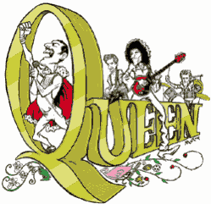
Recent Queen News
Queen is coming to Rock Band in October. The 10 tracks are: * Another One Bites The Dust * Crazy Little Thing Called Love * One Vision * Fat Bottomed Girls * I Want It All * I Want to Break Free * Killer Queen * Somebody to Love * Tie Your Mother Down * Under Pressure Or as one site put it, all the good ones except for Bohemian Rhapsody.
Brian May recorded a charity single, with all proceeds going to breast cancer research, in Abbey Road studios in late September.
As you may or may not know, there is a Queen musical called We Will Rock You. Apparently there is also going to be a movie with the same name coming out sometime within the next 1 or 2 years.
There is a Cosmos Rocks bundle coming out, not that anybody really cares.

Slide 8
NO DEACON CLOSE IN LEICESTER
Many thanks to Martin Patterson for sending the article which appeared in the Leicester Mercury newspaper.
Councillors have rejected their area’s two most famous son’s when choosing the name of a new street. Oadby and Wigston Borough Council had to name a road on a new housing development, which is between Leicester Road and Victoria Street, in Wigston. Developer Jelson put forward a number of suggestions for the road, including naming it after the most famous former Wigston resident, Graham Chapman. The comic genius and member of the Monty Python team grew up in the town where his father, Walter, was a police sergeant. Despite being part of one of the greatest comedy teams ever, there is no tribute to Chapman in the town. Councillors spurned the latest chance to provide some recognition of the star of Python films such as The Life Of Brian when it named the road Two Steeples. Coun. Bill Boulter is chairman of the council’s services committee, which took the decision earlier this week. He said they decided on a name which showed it’s historical links to the town as well as the site the houses are being built on – instead of the more famous option. He said “The site was occupied by the Two Steeples Hosiery Company. “Two Steeples also features on the coat of arms. Wigston was known as Wigston Two Steeples hundreds of years ago. That is where it stems from. It will be called Two Steeples Square. The houses are being built at the moment and the street name sign is the last thing to go up. It was the fact that it was the name of the hosiery factory that was on there as well as the name of the town” The name Two Steeples apparently comes from the Middle Ages as there were two churches in the town. All Saints and St Winstans. Councillors also rejected the name Deacon Close, which was suggested as a way of recognising Queen bassist John Deacon. The guitarist from the world famous band was born in Oadby and went to Beauchamp Grammar school, where he was in his first band. Jackie Smith, who runs the Queen fan club, backed the idea of some form of recognition of John’s roots within the borough. She said “I think it’s a fantastic idea. I think it would be really good to have something. It’s very difficult when deciding to name things after famous people, but I think there should be something for John, especially as he has always been the quiet one of Queen. I do honestly think he would be very touched if they did that”.

Slide 9
Book
Killer Queen is destined to become highly collectible. Over 200 pages are master-printed on to 11 different paper stocks, including acetate, trace and 200gsm matt art stock. The images and text are printed in monochrome and full colour with image varnishing.
'Rock's pictures of Queen's breakthrough gig at Imperial College in 1973 are just some of the rare and unseen images collected in Killer Queen...' Uncut, February 2004 'a book so ludicrously luxurious even by Genesis's standards... Even the candid shots scream, or gasp quality... When you see Rock's imagery...the price seems immaterial, darling.' Record Collector, December 2003 'this exquisitely produced photo book ... containing outtakes, test Polaroids, and other previously seen snapshots that might even surprise die-hard fans who thought they'd seen everything.' New Beats, December 2003 'One of the treasures in Killer Queen is Mick's cover shoot for the '74 LP, Sheer Heart Attack.' '... acres of unseen photos' Mojo, December 2003
Original text by Brian May, Mary Austin and Mick Rock Featuring quotes of the period from Freddie Mercury, Brian May, Roger Taylor and John Deacon A limited edition of 2,500 numbered copies worldwide signed by Brian May and Mick Rock

Slide 10
Queen were the rarest of breeds: both genius in the studio and utterly brilliant performing live. A potent, magical mixture that has won them fans the world over. Such is their success, Queen form part of collectors' so-called 'Mighty Three'. Along with The Beatles and The Rolling Stones, no other bands' recordings and memorabilia are so highly sought after. It is therefore fitting that Genesis follow their acclaimed Beatles and Rolling Stones titles with a limited edition tribute to a band captured in Mick Rock's lens at the explosive moment between obscurity and world domination.
Mick Rock was fast becoming the glam-rock photographer du jour when he turned up at Imperial College on the 18th November 1973 to take his first shots of an up-and-coming group called Queen. Now regarded as the band's breakthrough gig, Mick's photographs of the performance are just a small part of an archive of rare and unseen images preserved for all time in this large format volume.
Mick's collaboration with Freddie, Brian, Roger and John lasted until 1976 and Queen's legendary free concert in Hyde Park. During this time he helped create the iconic album covers for Queen II and Sheer Heart Attack and conducted solo photo sessions with Freddie and Roger. Previously unseen out-takes and test Polaroids from these sessions are included in the book, as are over 120 live photographs, many of which are being published for the very first time in this remarkable limited edition.

Slide 11
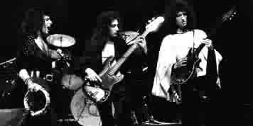
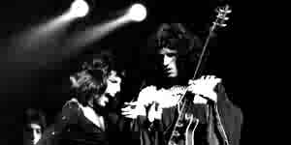
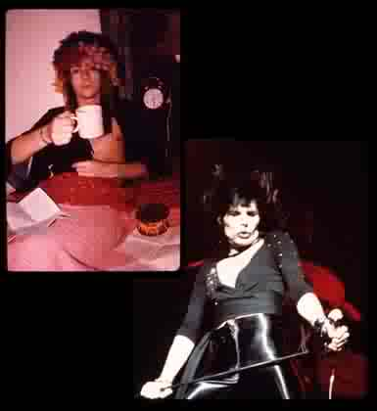
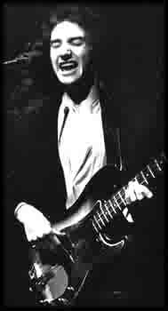
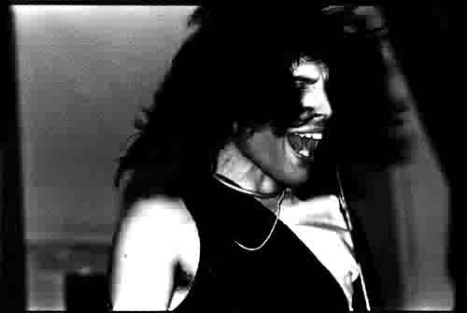
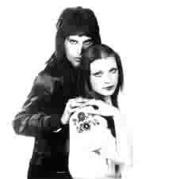
 | Brian May: Mick Rock is, and always was, a class act. We met, he and we young Queenies, at a point in our careers where the skies had opened up and creatively the scope of our journey was limitless - very exciting times.
 | Brian May: Looking back, it is obvious that Mick was a master of his art very early on. The images in this book (including many we rejected at the time, sometimes for artistic reasons, sometimes for reasons of vanity!) stand up fresh and untarnished by time. His handling of keylight and shade, his figuring of faces, his awareness of sheer texture, are all superb. His pictures speak louder than words. Thank you, Mick Rock, for the excellence you achieved with us and for us. It was almost worth lying on the floor covered in Vaseline, having cold water thrown over us!
 | Mary Austin: With Freddie there were always new heights, always new images, new thoughts. I feel he had a right to enjoy his third eye and the right to enjoy himself, and all I ever really wanted to do was protect him so that no one would hurt him.

Slide 12
Absolute Greatest (CD)
The legendary rock band, Queen, announced on September 26th that they are making music history with the release of their new album, Absolute Greatest - the ultimate compilation of the band's most popular, enduring and iconic songs on EMI Music's Parlophone Records. In an industry first, Queen are joining up with Logitech to offer Absolute Greatest exclusively on the company's new Logitech Squeezebox Radio Wi-Fi music player. As of today, owners of the Logitech Squeezebox Radio can listen to the new Queen album before it hits the shops on November 16 and experience a series of unique Queen photos and track-by-track audio commentaries recorded by the band.
For seven weeks, leading up to the album's availability on November 16, Queen fans who own a Logitech Squeezebox Radio will have exclusive access to the complete Absolute Greatest album, track lyrics and a series of Queen photographs that have been made available for the first time. They can also enjoy exclusive track-by-track audio commentaries in which Brian May and Roger Taylor talk through the composition and history of each famous song. All they need to do is select the Queen application found under the Squeezebox Radio's new Apps menu.
Queen's Roger Taylor said: "What a thrill to be first past the post on this new and mind- boggling technological innovation; another exciting step on our long journey."

Slide 13
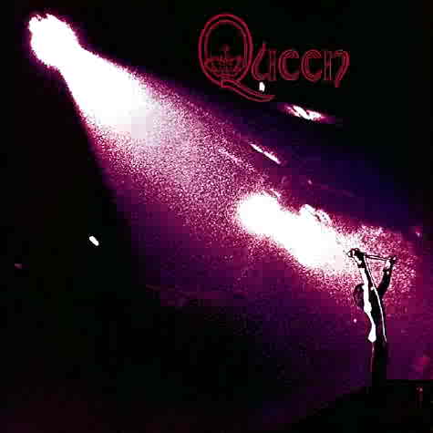
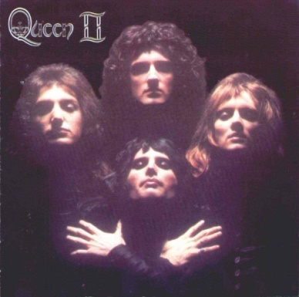
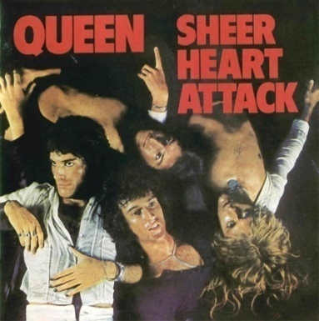
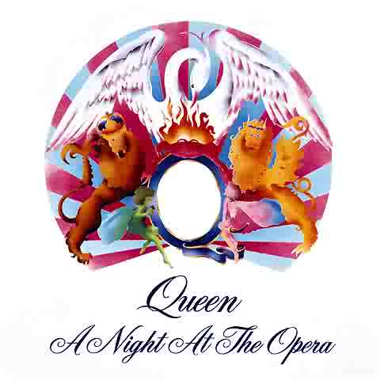
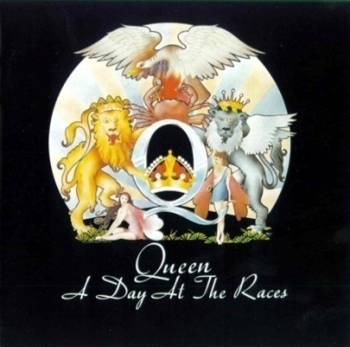
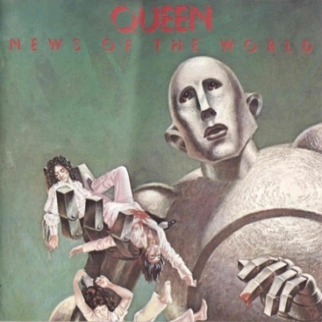
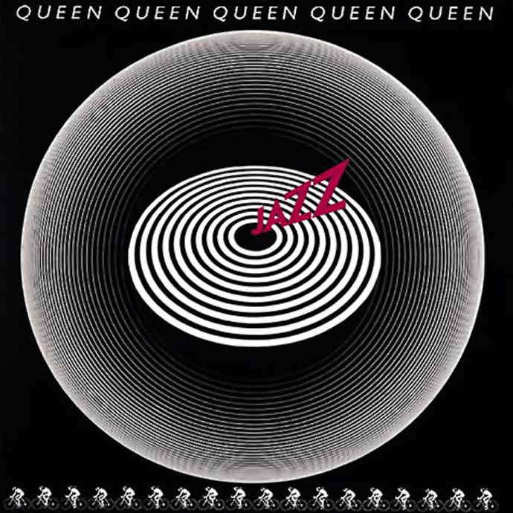
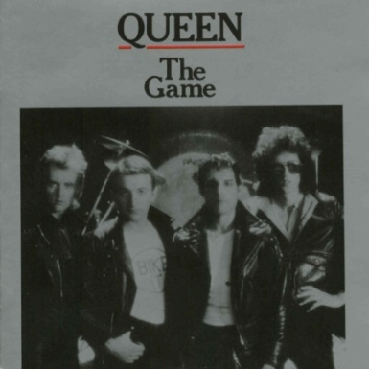
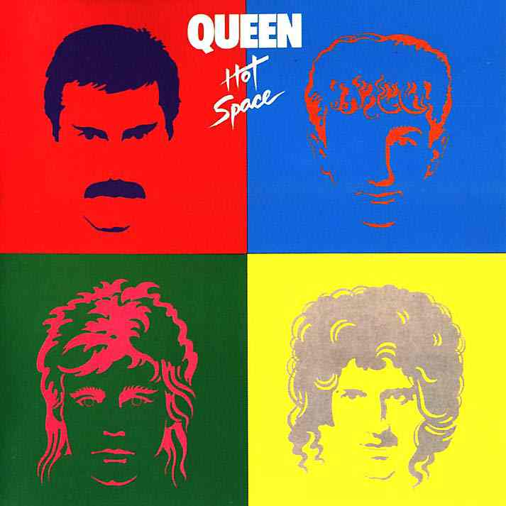
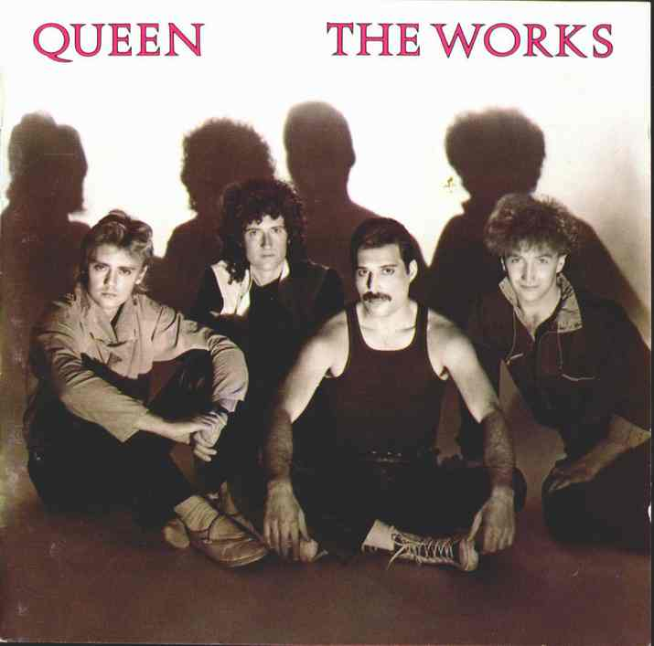
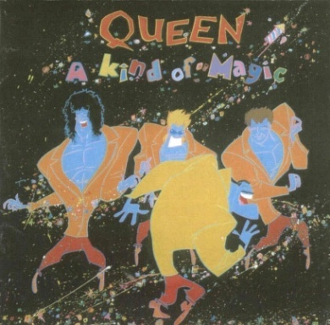
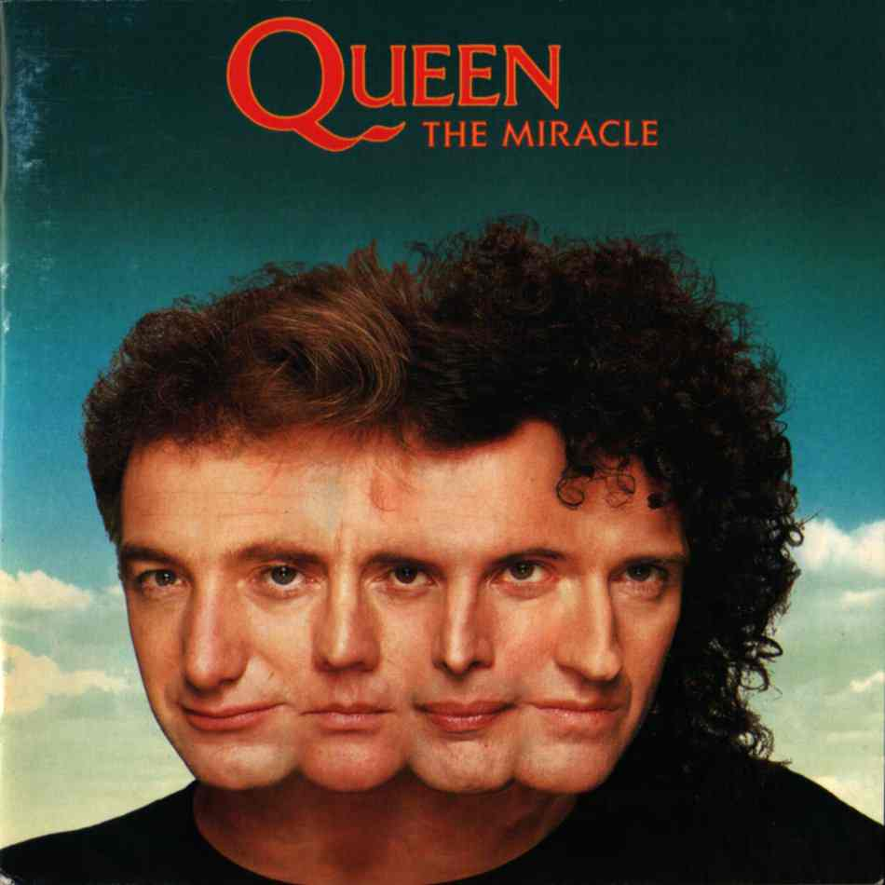
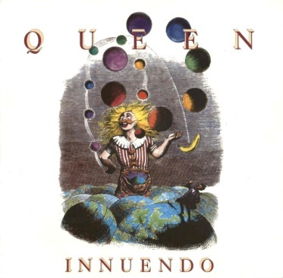
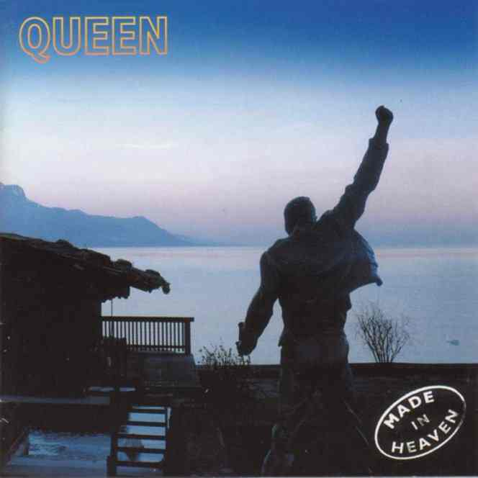
Studio Albums
Top Row: Queen (1973), Queen II (1974), Sheer Heart Attack (1974), A Night at the Opera (1975), A Day at the Races (1976)
Middle Row: News of the World (1977), Jazz (1978), The Game (1980), Hot Space (1982), The Works (1983)
Bottom Row: A Kind of Magic (1986), The Miracle (1989), Innuendo (1991), Made in Heaven (1995)

Slide 14
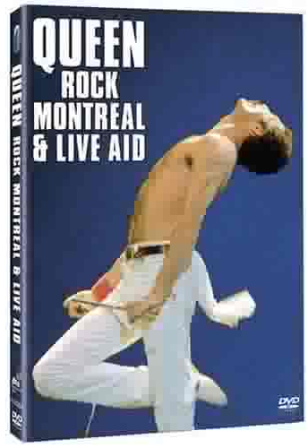
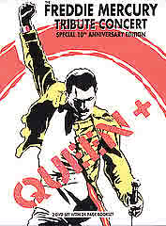
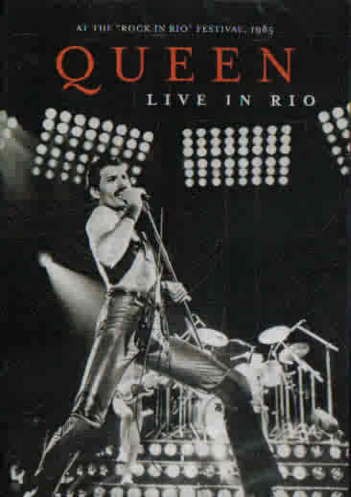
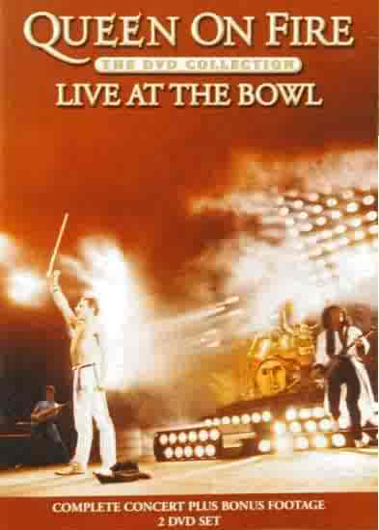
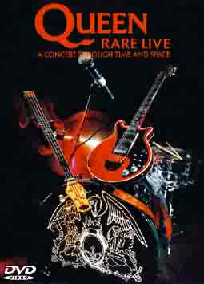
DVDs

Slide 15
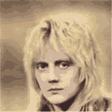
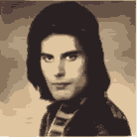
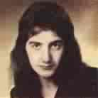
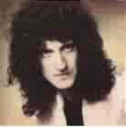
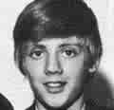
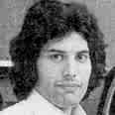
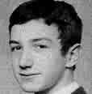
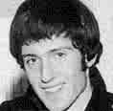
The Members

Slide 16
Freddie Mercury
Full Name: Farrokh Bulsara
Birthday: September 5th, 1946
Birthplace: Zanzibar
Siblings: Kashmira (younger)
Degree: Diploma of Art & Design
Pet Peeve: Slice Bread – DC10’s
Musicians Most Influenced by: Hendrix, Paganini
Groups Disliked: AC/DC, The Clash, tedious rock bands
Greatest Achievement: success
Instruments Able to Play: piano, acoustic guitar
Favourites
Musician: Jimi Hendrix, John Lennon
Group: Mott the Hoople, the Jacksons
Albums: Up Against the Wall, Imagine
Book: Peter Rabbit, A View From Abroad
Writer: Beatrix Potter, Richard Dadd
Movie: Some Like it Hot, and Mae West movie
Colour: black
Actor: Timothy Dalton
Actress: Marilyn Monroe, Liza Minelli
Food: Indian Food, Nectar
Drink: Champagne in a glass slipper
Instrument: piano, harpsichord
Queen album: The Game
Queen song: Somebody to Love
Country: Japan, England

Slide 17
Freddie Mercury
At just one year old, Freddie had his first taste of fame when the local photographer took his picture and displayed it in his shop window - to be awarded first prize in a baby contest. At the age of five he started to attend the Zanzibar Missionary School, which was run by British nuns.
When going to Ealing College, Freddie was good at impersonations of Jimi Hendrix and would mime outrageously to his songs, using a ruler as a guitar.
He used to collect stamps, which were bought by some British postage museum for $40,000 or so.
Freddie had 30 pet Japanese carp fish worth at the time he bought them 1,000 pounds each. However the poor fancy fish met a tragic end when they died after their pool being cleaned.
Freddie had an extravagant taste in art. He once bought a set of hand-painted china for 250,000 pounds and went to Geneva to learn how to make the stuff himself.
All of Freddie’s bi and male friends had female nicknames that Freddie named them
Freddie was the first ‘gay’ (even though he is bi, which is different) man to attain Rock God status
Freddie Mercury's original name was Farrokh Bulsara, until he wisely decided to change it to something pronounceable by English speaking folks.
Cirolana mercuryi is a crustacean named after Freddie Mercury.
Apparently he was 5’ 9” tall before he died.

Slide 18
Some Random Freddie Quotes
“I won’t be a rockstar, I’ll be a legend.”
“I always knew I was a star. And now the rest of the world seems to be agreeing with me.”
“Money may not buy happiness, but it can damn well give it!”
“Women are like modern paintings. You can’t enjoy them if you try to understand them.”
“The most important thing is to live a fabulous life. As long as it’s fabulous I don’t care how long it is.”
“I keep wanting to leave but they won’t let me!”
“Money may not buy happiness, but it can damn well give it!”
“It smells like shit in here!”
“We’re not just an average, normal rock group really, we’re just very weird. We do things that people least expect, not just for the sake of doing them but because it is just the phase we are going through”
“The concept of Queen is to be regal and majestic. Glamour is part of us, and we want to be dandy and it was the dandy thing we were into: dressing up, fooling around. Even in those days we knew we’d make it” (‘74)
“Go pretty boy go!”
“I’m a man of extremes” (’74)
“We know we’re good, we know what we want, and it’s no good anyone trying to talk us out of it” (‘74)
“If people as me if I’m gay, I tell them it’s up to them to find out”
“People are very apprehensive when they meet me. They think I’m going to eat them” (‘77)
“When we started off, rock bands were all wearing jeans– and suddenly here’s Freddie Mercury in a Zandra Rhodes frock with make-up and black nail varnish. It was outrageous!” (’71)
“It couldn’t have been King, it doesn’t have the same ring or aura as Queen”

Slide 19
Brian May
Full Name: Brian Harold May
Birthday: July 19th, 1947
Birthplace: Hampton, Middlesex
Degree: physics, astronomy
Pet Peeve: public life intruding on private life
Children: Jimmy, Louisa, Emily Ruth
Musicians Most Influenced by: Who, Hendrix, Cream, Beatles
Groups Liked: Led Zeppelin, The Who, Van Halen, Kansas, Pink Floyd
Groups Disliked: Omen, Carpenters
Greatest Achievement: ?
Instruments Able to Play: piano, ukulele, acoustic guitar, electric guitar
Favourites
Musician: John Lennon, Jimi Hendrix
Group: The Beatles
Albums: Sergeant Pepper, Abbey Road, Band of Gypsies
Book: Glass Bead Game, Out of the Silent Planet, Steppenwolf
Writer: Herman Hesse, C.S. Lewis
Movie: Wizard of Oz, Snow White, Clockwork Orange, Women in Love, FURIA
Colour: black
Actor: Clint Eastwood, James Mason
Actress: Natalie Wood, Goldie Hawn
Food: Japanese food, Vegetarian,
Drink: Guinness, grapefruit juice
Instrument: guitar
Queen album: Queen II

Slide 20
Brian May
At the age of 5, Brian’s parents enrolled him in piano lessons. Brian hated those lessons as he had to practice every Saturday.
When Brian was 6, he began to take an interest in photography & astronomy. He was given a camera of his own, and he constructed a small telescope. To this day both astronomy & photography play an important role in his life, since he’s an astrophysicist and a collector of early stereographs.
Brian is so overprotective of his Red Special that when he was travelling by plane once he bought a seat for specifically for it, since he couldn’t think of it being carelessly tossed into the luggage carrier thing like a worthless piece of junk, and it couldn’t fit into the overhead compartment.
Brian was seriously ill in 1974, when he collapsed with Hepatitis in the middle of their US tour, which had to be cancelled. Recovering from the illness, Brian recorded his bits on Sheer Heart Attack in-between rushes to the bathroom
Brian didn't officially graduate college until May 14th 2008 (he was 60)
He was, at one point, very depressed, and even thought seriously about driving off a bridge to end his problems.
He broke his arm skateboarding in the US in 1989.
Apparently he is 6’ 1.5” tall

Slide 21
Some random Brian Quotes
"I'm into paradoxes. I wanted to make an album about them, but the group told me I was a pretentious fart. They were right."
“Lovely! Lovely lights! We love our lights!”
“Oh Freddie-poos, where are you!?”
“I despise the lottery. There’s less chance of you becoming a millionaire than there is getting hit on the head by a passing asteroid.”
“I have to build my own boat this time!”
“Sounds like a lot of bullshit doesn’t it?”
“You can’t create music in a vacuum.”
“We argue fiercely. But there’s that point where you know you’ve said your bit and you should back down”
“You just toss around hundreds of names. We have loads of names”
“I’m kind of a weird animal”
“Very well done chaps!”

Slide 22
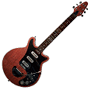
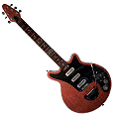
The “Red Special”
Brian’s guitar, the “Red Special”, which he made as a teenager with the help of his father, was made out of the following parts.
The neck was hand carved by Brian from an old mahogany fireplace mantel that a friend was throwing out.
The body was made out of a piece of oak and whatever other wood he and his father could find.
The fret markers were buttons found in his mother’s button box.
When making the pickups, Brian bought 3 burns pickups, which of course Brian modified himself.
The whammy bar was made from a kick stand taken off of an old motorcycle.
The bridge was hand carven out of steel and the tremolo system included 2 springs from an old motorcycle.
And why did Brian & his dad do all this? Because the guitars on the market weren’t good enough, and were quite expensive.

Slide 23
Roger (Meddows) Taylor
Full Name: Roger Meddows Taylor
Birthday: July 26th, 1949
Birthplace: Kings Lynn, Norfolk
Siblings: Clare (younger)
Degree: biology
Pet Peeve: Journalists, parasites, racial and religious bigots, patriots, extreme left and right
Children: Felix, Rory, Rufus, Tiger Lily, Lola
Musicians Most Influenced by: Hendrix, Hank Marvin, John Bonham, David Bowie
Groups Disliked: Osmonds, Carpenters, Ray Conif (sic) and other such muzak rubbish
Greatest Achievement: Getting rich– it’s not easy
Music most influenced by: Guitar music since 1950. Rock - especially Hendrix & Dylan
Instruments Able to Play: drums, guitar,
Favourites
Musician: Jimi Hendrix, John Lennon
Group: The Who, Jimi Hendrix Experience
Albums: Plastic Ono Band, Electric Ladyland, The White Album
Book: On the Road, Dune
Writer: Jack Kerouac, Mervin, Peake, C.S. Lewis
Movie: 2001: A Space Odyssey, Clockwork Orange, King Kong, The Great Race, Close Encounters
Colour: silver, anything but orange
Actor: Tony Curtis, John Hurt
Actress: Jane Fonda, Brigitte Bardot
Food: Japanese, Spicy food
Drink: Vodka, Southern Comfort
Instrument: drums
Queen album: A Night at the Opera
Queen song: The March of the Black Queen

Slide 24
Roger (Meddows) Taylor
Roger was a pretty smart child. He realized that if he were in a band, he might make some money!
He left Truro School with seven O levels- in English language, English literature, biology, physics, chemistry, French and math, and three A levels in biology, chemistry and physics. Roger was an ubersmart child!
When he bought his first Range Rover he claimed "You can park them on a sixpence." He had to be towed out of a ditch. His Ferrari burst into flames on his way to the south of France, and his Aston Martin also burst into flames. The first car he ever got practically disintegrated just two days after he bought it. He doesn't actually count that one in the list of cars he's owned.
He has lived in Guildford Surrey England since the 1974 video shoots for “We Will Rock You” and “Spread Your Wings” which were filmed in his backyard. At the time, the people he bought the house from were still living there.
As you may or may not know, Roger left Dominique Beyrand for Debbie Leng (also known as “flake girl”) in the 80’s. If Roger never formed The Cross, he would’ve (probably) never met Debbie, since they met at a The Cross photo shoot.
Apparently he is 5’ 10.5” tall
He was arrested in 1983. I believe it was this time that he was arrested for something he didn’t do, with some guys that I can’t quite remember the name, and spent the night in jail. They laughed about the whole thing, probably because they were drunk.
He was shot with a bee-bee gun when he was a child.
Roger was very frail as a child, and would come off the rugby field white and shivering, which his friends found amusing (who wouldn’t?)
Apparently he didn’t learn to swim until he was 22. It was said that he had a fear of drowning.
His Ferrari’s engine caught fire whilst in France in 1978
In 1989, Roger had an enormous party to celebrate his birthday. It had two huge searchlight spotlights to scan the sky over his house. People living near by thought they were UFOs and were driving towards the lights from right across Surrey & Hampshire to see if aliens were landing! The police got many calls about the lights, and people were pulling up on the road that went by his property. The event also made the front page of the next day’s newspapers, and it certainly was one heck of a party.

Slide 25
When he was 16, he crashed his group’s van into a fish truck in thick foggy conditions, seriously hurting one of his friends. The matter wasn’t resolved for several years.
His father was known as eccentric for doing things when he was upset, such as walking the cliffs and riding his motorcycle in the garden.
He grew a beard in 1969/1970 because people on the streets kept mistaking him for a woman.
A few days after his Ferrari caught fire, he & a couple of friends set off on a boat of the shore of France. The boat stalled and they were stranded for 3 hours until they were towed back to the coast.
During the early 1970’s, the band was up in Liverpool one night, and were walking down the street in their fancy 70’s clothes. Let’s just say people didn’t dress like that at the time. They came across a bunch of gang members who threatened to beat them up, and Roger quickly flashed his student card and told them it was judo license and by law he was permitted to beat them up for self-defense. The gang members backed off.
Roger & Crystal were fed up with a female journalist, so they decided to drown her. (they were drunk) They got to the pool, but it was locked, so they shook the doors, shattered the glass in them, and ran off.
Whilst in South America, Roger, John & Crystal decided to rent a car and drive to a town some 100 miles away. John was smarter and took a limo, but Roger & Crystal weren’t. The car eventually broke down on them, and a huge rainstorm developed and, to top it all of, the car had no top. A mudslide occurred nearby and all the rain on the ground turned brown from the mud. Roger & Crystal also turned brown when a transport truck passed the and splashed the dirty water all over them and their car. They managed to make it to their destination, and after hurling some ‘colourful language’ at the rent-a-car company, they didn’t have to pay for their car.
He wanted to put giant stone lion statues at the entrance of his Surrey property, but the local authorities said no. Instead, he put of hundreds of glow-in-the-dark gnomes.
He was so bent on have “I’m in Love with My Car” as the B-side of “Bohemian Rhapsody”, that he locked himself in a cupboard until Freddie agreed.
When he was in good mood, he often added a nice graphic version of the word 'Queen‘ when he autographed things

Slide 26
Some Random Roger Quotes
"I've got some old sci-fi books and magazines which I browse through from time to time. Maybe there are things up there in space watching us. I wouldn't find that surprising at all.”
“We still have the rock ‘n’ roll Gypsy mentality. Even after 12 years without a line-up change we still really enjoy the buzz from playing live and the fact that we have hit singles. Some bands in our position might take it all in their stride, but we’re still like kids, we get very excited.”
“Before Queen I ran a clothes store with Freddie in Kensington Market. In fact I sold Freddie’s own coat three times!”
“We’re quite normal I think it’s just that we’ve been luckier than a lot of people and we probably worked harder to.”
“Live with your memories and keep them as memories and that’s great. Forget the bad times and just remember the good ones and you know and hope tomorrow is a good day”
“I was in a band with Brian, and Freddie would sort of run around with us in those days”
“We try to get some good feeling and atmosphere and excitement and ambience I suppose”
“We couldn’t afford lights so we asked the audience to bring candles and cigarette lighters”
“I hate to generalize it, but– generally speaking– I hate it!”
“It’s a lot like baling hay”
“That’s right. But it’s wrong. Upside down, isn’t it? It’s a bit silly, not to mention ironic”
“…He might as well be talking about cupcakes…”

Slide 27
John Deacon
Full Name: John Richard Deacon
Birthday: August 19th, 1951
Birthplace: Oadby, Leicester
Siblings: Julie
Degree: electronics- 1st class honors
Pet Peeve: snobs
Children: Robert, Michael, Laura, Joshua, Luke, Cameron
Musicians Most Influenced by: Chris Squires, Philip Chen
Groups Liked: Nolans, Adam & the Ants, Bad Manners, Blondie, Gonzalez, Yes
Groups Disliked: , Japan, Brotherhood of Man, Toyah, Whitesnake, Clash, country & folk music
Greatest Achievement: "Writing" a No.1 in the USA, Canada, Spain, Argentina & Guatemala
Admire Most: Modest talented people
Music most influenced by: Rock; Soul
Instruments Able to Play: bass guitar,
Favourites
Musician: Tony Thompson, Stevie Wonder, Leon Sylvers III
Group: Whispers, Sky, Commodores, Chic, Police
Albums: The Last Dance, My Aim is True, Off the Wall
Book: Roots, Rebecca, The Grapes of Wrath
Movie: One Flew Over The Cuckoo's Nest, Wizard of Oz, Clockwork Orange, The Prime of Miss Jean Brodie
Colour: silver, black
Actor: Jack Nicholson
Actress: Jane Alexander
Food: Cheese on toast
Drink: milk, tea
Instrument: bass guitar
Queen album: The Game
Country: Japan, Brazil, USA

Slide 28
John Deacon
John’s father encouraged John to tinker with electronics, something his father liked to do himself.
John used to be a paper boy, and saved up his money to buy a proper guitar.
John’s first band was called The Opposition. Sometime in the end of 1966, the bassist of the group left, leaving John to fill the gap. Because of the new line up, the band changed their name in a daring move to The New Opposition. This was changed again later to ART, and John left the band in 1969.
He did not take part in the music scene at Chelsea College, but of course brought along his old acoustic guitar just in case an opportunity came up.
In October 1970, John went to see Queen (obviously this was before he joined). For the performance, they were all dressed in black and the lights were dim, so all he saw was 4 shadowy figures. They didn’t make a lasting impression to him… at the time.
At the beginning of his second year in college, he realized he missed music, so he convinced his mother to drive his equipment to school for him.
His legendary Deaky amp was constructed in 1970, before he joined forces with Queen.
One of his ‘stage habits’ was licking his fingers before hard bass parts
He’s the creator of the some-what famous “Deaky Dance”, which involves things like bobbing your head, jumping up and down, spinning, among other things. So far, he is the only one who has mastered it.
John Deacon’s dad died when John was eleven. It’s something that he doesn’t like to talk about. Really the only thing he says about it is that it was rough and not easy growing up without a dad.
Apparently he is 5’ 11” tall

Slide 29
Some random John Quotes
“Because our records sell all around the world, everybody should be financially secure for the rest of their lives”
“In England we live in a semi-detached Victorian house, ‘cos we like Victorian houses you know”
“Oh…. I’m terribly shy and nervous”
“If I could sing it would be lovely”
“Freddie’s got a nasty temper…. I remember one time he lost it, he smashed a very large ornate mirror over someone’s head”
“I’ve got a nice house, a loving wife and a couple of kids- that’ll do me!”
“I don’t want to be nasty!”
“Arguments are healthy. They clean air”
“If I could tell the future life would be boring.”
“Lots of marriages don’t last as long as Queen’s been together”
“I’ll probably make loads of plans, and then just sit around on my bottom all day and do nothing.”

Slide 30
Sites (official & non-official)
www.queenonline.com - Queen’s official site
www.brianmay.com - Brian May’s official site
www.queenonline.com/old.html - Queen’s official ‘old’ site
www.queenworld.com – International Queen Fanclub
www.queenzone.com – news, pictures, etc.
http://gr8kingrat.com/ - stuff about tours, concerts, etc.
www.queenconcerts.com – Queen concerts
www.queenpicturehall.com – Queen rarities
www.meddows.com – fan site
www.queenautographs.com – Queen autographs
www.queencaptionsheaven.com.ar – 700+ Queen captions
www.queenoz.com – lots of pictures
www.queencuttings.com – Queen cuttings & clippings
www.queenmuseum.com – pictures of rare Queen collector items
www.queenarchives.com – articles, interviews, album reviews, etc.
www.queen-headquarters.de – German fan site
www.queenfreddie.com – Italian fan site
http://queenphotos.blogspot.com –
www.mercuryparadise.com
http://en.queenvision.com/index.php?content=index - Queen items
http://www.queensongs.info/ - Queen tabs, chords, sheet music, album/song analysis, etc.
http://www.queenrocks.ru/
http://www.queenonstage.com/ - info page for collectors of original Queen bootleg records
http://www.mercuryphoenixtrust.com/
http://www.brianmayworld.com/
www.ghostofasmile.com – everything about Smile
www.queencollector.com – Queen rarities
www.deaky.com – John fan site
www.mercury-and-queen.com -
http://mr-mercury.co.uk/ -
www.queenlive.ca – Canadian Queen site, mainly about concerts
http://uberstories.weebly.com – awesome stories about Queen, their kids, & their friends
www.queenmustgoon.net -
www.freewebs.com/isthisthereallife/Picturesgallery.htm -
http://queenvinyls.com – queen vinyl single covers
www.rhyequeenbyethost22.com/index.php
http://www.freewebs.com/roger_taylor/roger411amustread.htm - Roger Taylor fan site
http://rogertaylor.info/ - Roger Taylor fan site
http://www.rogersmeadows.com/ - Roger Taylor fan site
http://roger-taylor.net/Main.htm - Roger Taylor fan site
www.queenpedia.com – the Queen encyclopedia
www.pcpki.com/queen/pre.html - list of all Queen songs, lyrics, guitar/bass tabs, etc.
www.ultimatequeen.co.uk –
http://www.mayniacs.com/index2.html - Contains all things related to Brian, including extensive MP3 download section for rare tracks

Slide 31
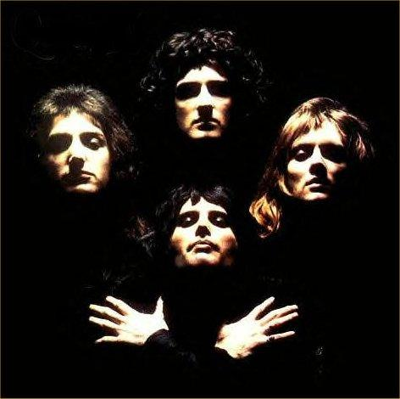
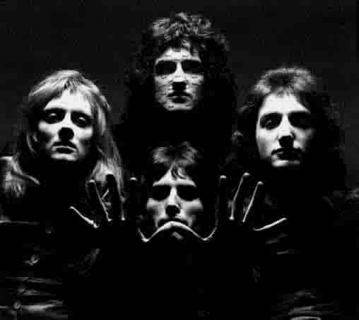
This PowerPoint is dedicated to Queen, the best band in music.
If you thought this presentation sucked, you suck… a lot.
The End
of this presentation…
The Show Will Go On…. just not this one

