Slide 1
the best of
Pictures With Comments

Slide 2
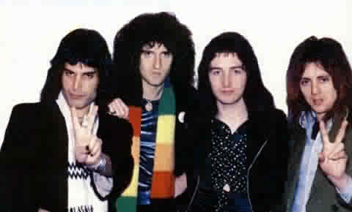
War
Peace
Peace
Relaxation

Slide 3
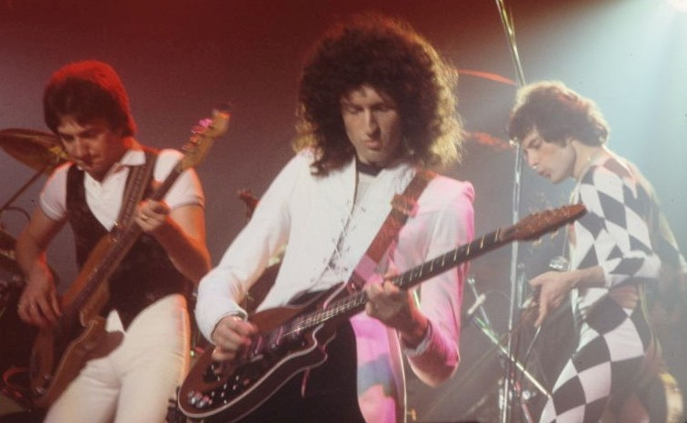
Ooh! A penny!

Slide 4
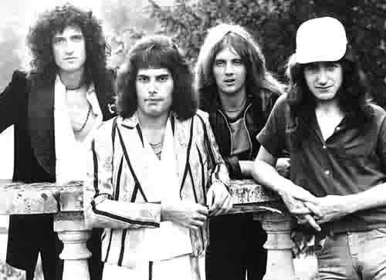
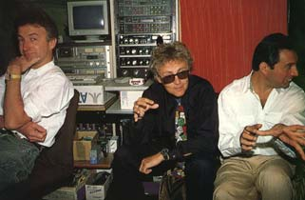
Roger and Freddie got drunk and stole some of the Invisible Man’s stuff
It looks like someone cut the top of John’s head out of the picture

Slide 5
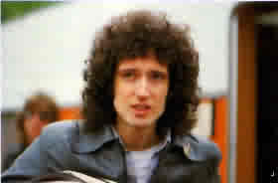
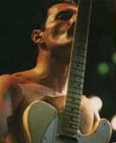
Brian what did you do!?
Freddie loves his guitar. His acoustic one is better.
Freddie still loves his guitar.
Brian feels guilty about whatever he did

Slide 6
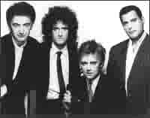
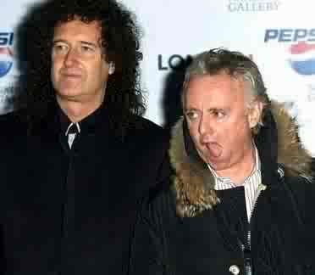
Anger-face stare-down Brian
Stare-down John
Freddie
Evil stare-down Roger
I wonder what happened to Brian…
tards
..he probably left because cleverness was sorely lacking everywhere

Slide 7
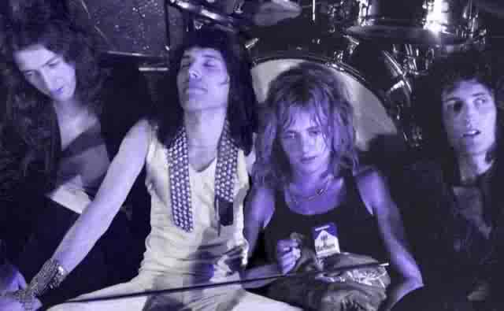
On one of their tours, Queen ran out of food, so they all lost lots of weight. They managed to survive using Roger’s massive collection of alcohol stored in his bass drums. After they realized they could simply buy some with their money, they went out for ice cream.

Slide 8
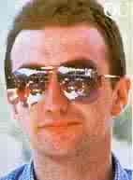
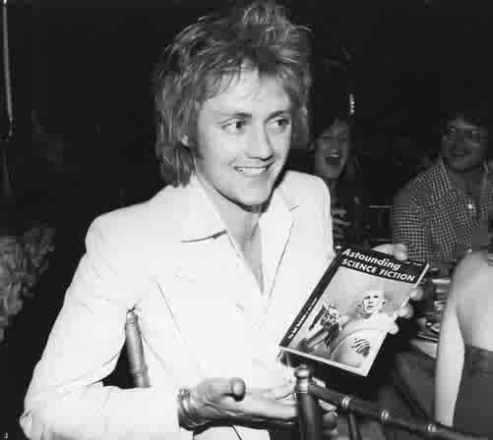
Introducing the….
…I can’t believe I’m reading a book called ‘Astounding Science Fiction’ either!
John Deacon sunglasses!
Wait, I’m not, I’m just holding it.

Slide 9
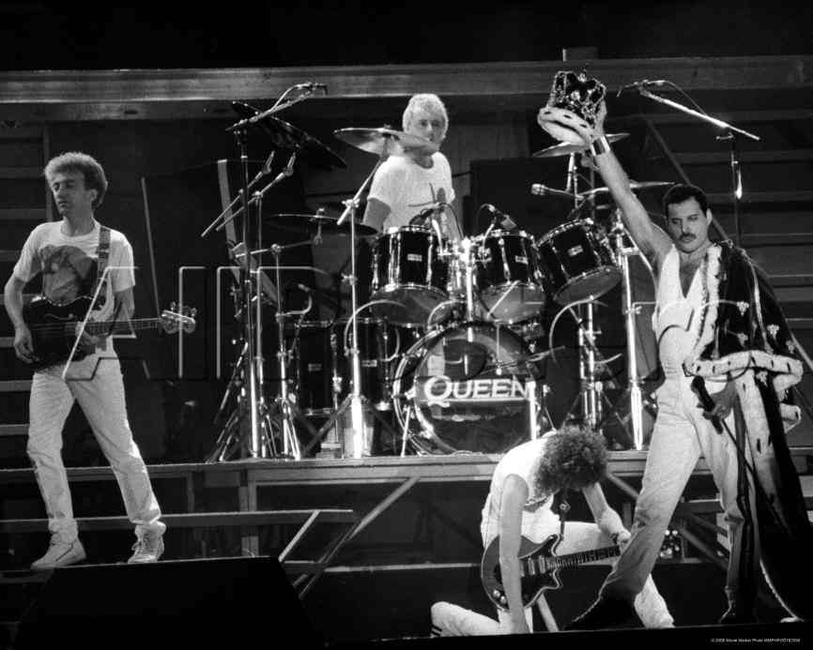
The Invisible Man shoved Brian, and Brian fell! What are you doing Invisible Man!? Queen did an epic song about you and this is how you pay them back!? Tisk tisk Invisible Man. Tisk tisk

Slide 10
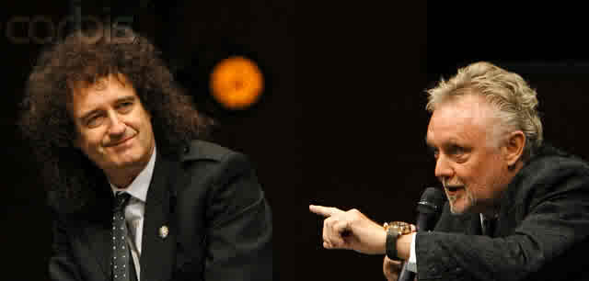
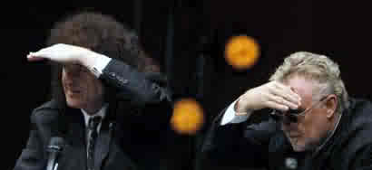
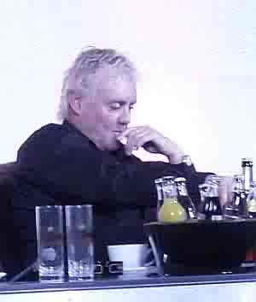
Where?
Yeah right
Holy hell! It’s ANITA! (dunna dunna naa….)
No really!
Over there someplace. I can’t really say. I can’t see a thing!
I think looking at him, I mean uh, her, made me go blind!
Crusty old man Roger can’t decide on a drink. Tard muffin. No! Crusty old muffin.

Slide 11
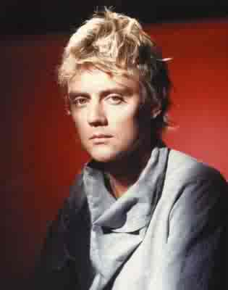
…but it’s not nearly as bad as John’s outfit.
Roger’s shirt may look really mental…

Slide 12
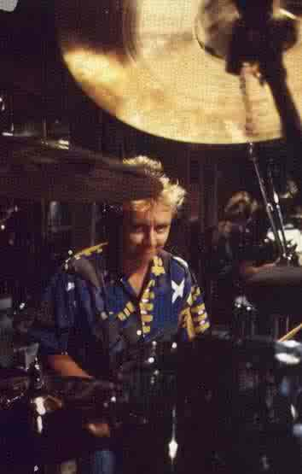
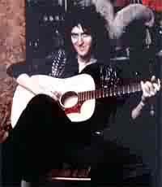
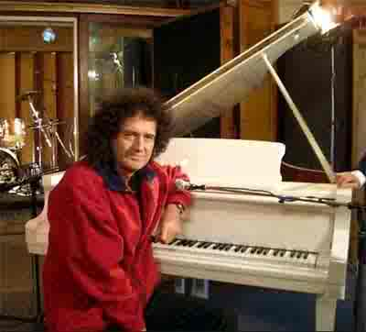
Watch out Brian! The hand is coming to get you!
AKA that
The scariest, creepiest Brian picture– EVER!
It’s worse than Roger’s Mr. Stalker-Evil-Scientist-Man face!

Slide 13
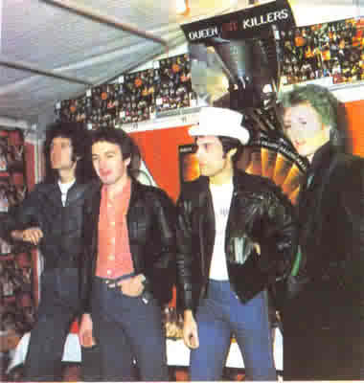
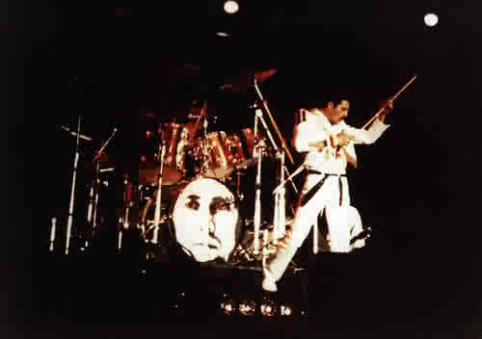
Übertard with green hair!
OH NO! Someone cut of the bottom half of Freddie’s left leg! (maybe 1986 Roger ate it)

Slide 14
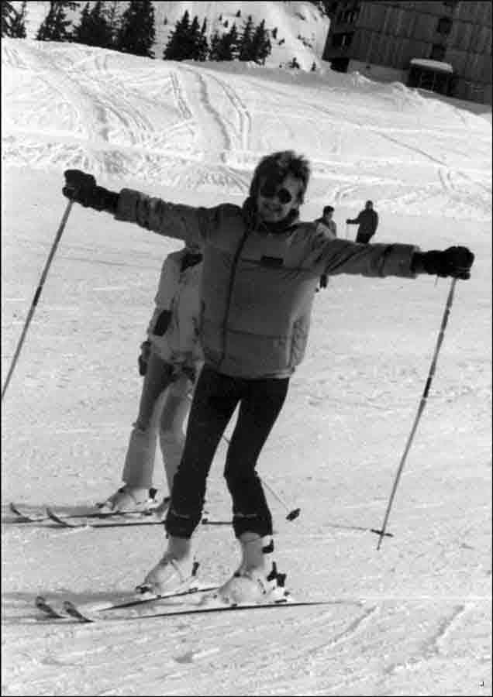
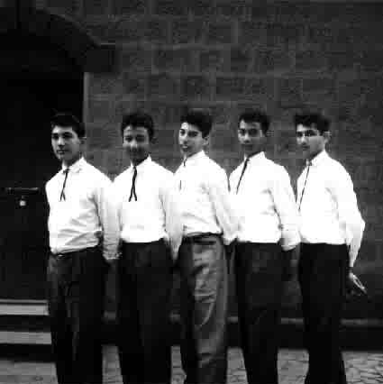
Yogi’s First Christmas Roger’s First
Ski Trip
I have different colour pants than the rest of you because I’m just that more awesome

Slide 15
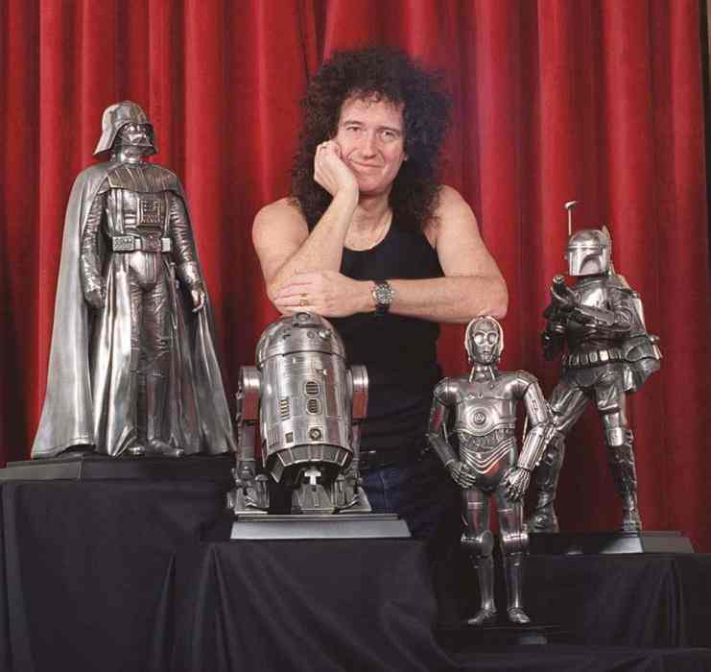
Star Wars is better than Star Trek. Just ask Brian.

Slide 16
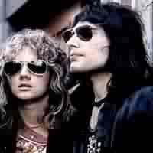
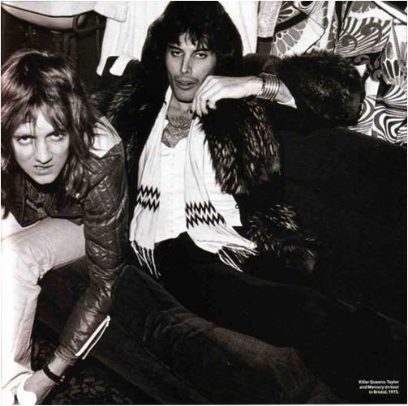
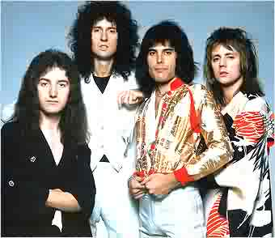
Queen’s turning Japanese.
Roger and Freddie think they are so cool. Little do they know, they’re not.
Just kidding, they are.
Except in this picture

Slide 17
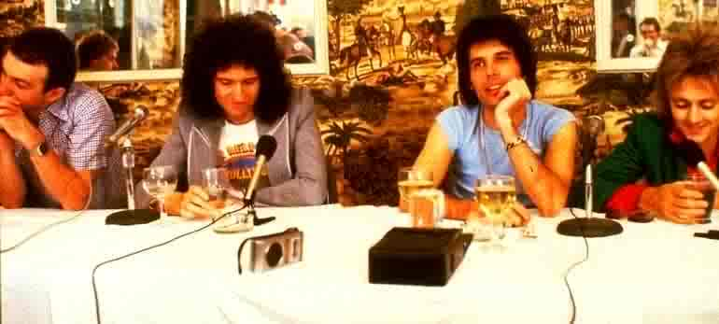
John is… well, not interested
Brian is… also not interested
Freddie is daydreaming
And Christmas Roger is admiring his drink
Queen at a press conference.

Slide 18
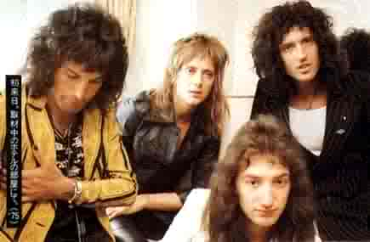
Heart failing… breathing stopping… death coming…
I can see you Mr. Camera Man! I can always see you… even when you don’t think I am, I am watching…
I want those cookies…
Oh my god… my shoes don’t match
Everyone is too ‘busy’ to notice Roger is slowly dying.
Ok, that was dumb.

Slide 19
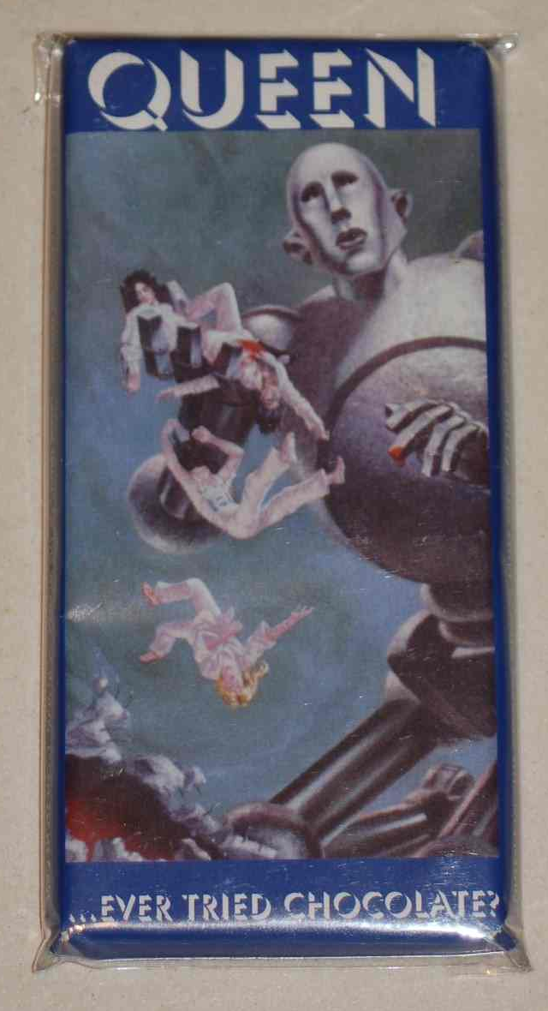
Introducing, the one, the only, the…
…Queen chocolate bar!

Slide 20
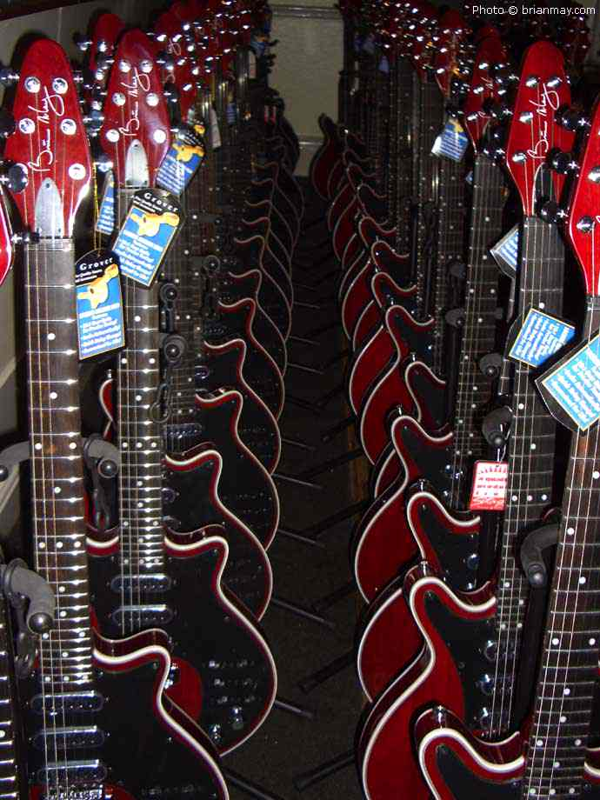
The herd of Red Special’s are Coming Soon for you!!!

Slide 21
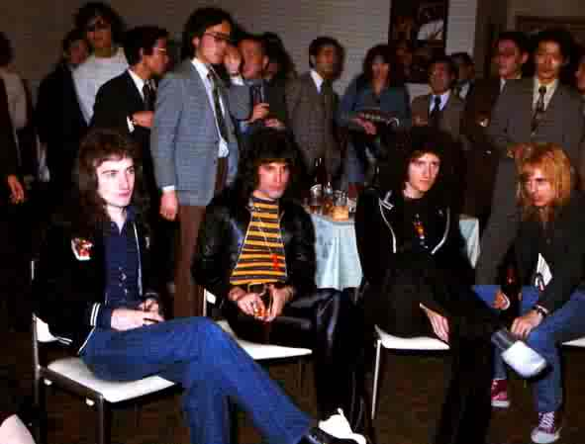
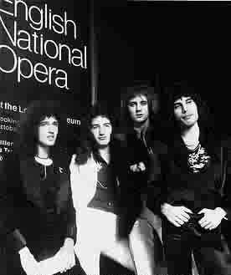
Queen is going to spend A Night at the Opera (ha ha, that wasn’t funny)
Queen is so awesome, they get to sit when everyone else has to stand.

Slide 22
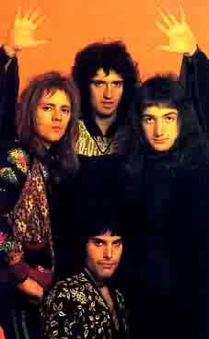
I have 2 comments for this next picture.
1
2
High-fives!
And
No.
Oh no! It’s Brion! The two-headed rockstar!

Slide 23
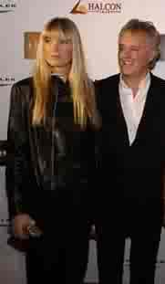
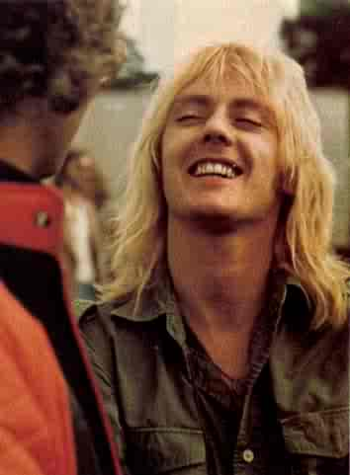
Roger likes blonde girls so much…
…that he wanted to look like one to!

Slide 24
This picture is just plain funny.

Slide 25
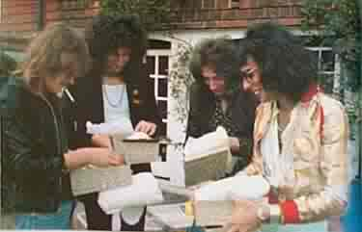
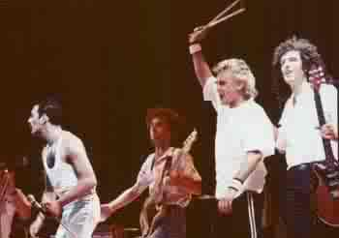
Roger can make unwrapping presents dangerous to your health.
Hey look! It’s monster-gargantuan Brian and Roger and their ubersmall friends!
*BTW: Roger is not huge cuz he’s 1986 Roger. He’s 1985 Roger.

Slide 26
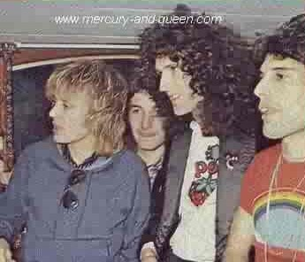
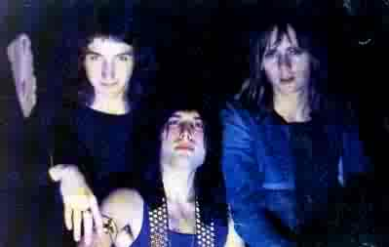
Brian went Back to the Light, but the rest of Queen remained on the Dark side.
Roger looks really young here. Actually, they all do. (maybe not Brian though)

Slide 27
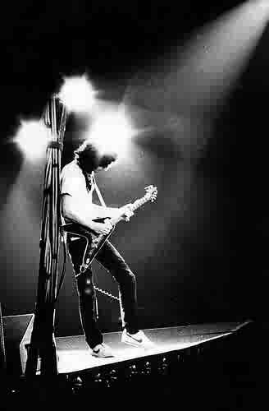
Brian has a bright idea.
Roger & Freddie sharing an eye– denied!

Slide 28
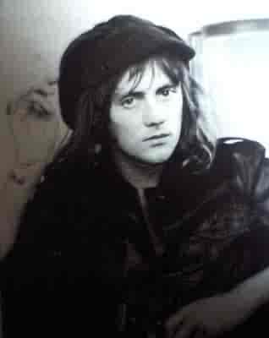
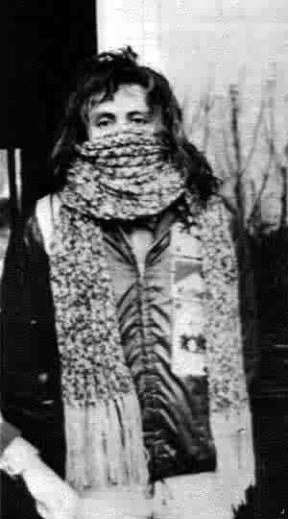
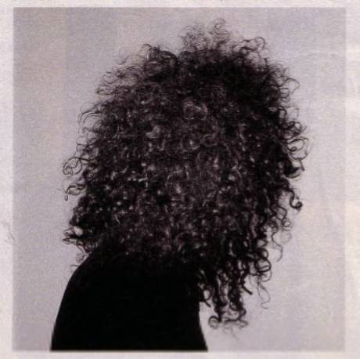
Roger’s hat lots übermentaltastic to the extreme! When will he learn that his hat is dumb?
OMG! Brian’s hair has taken over his head!
Answer: Never. It’s Roger.
I think he might be a tad chilly.
NOOOO!

Slide 29
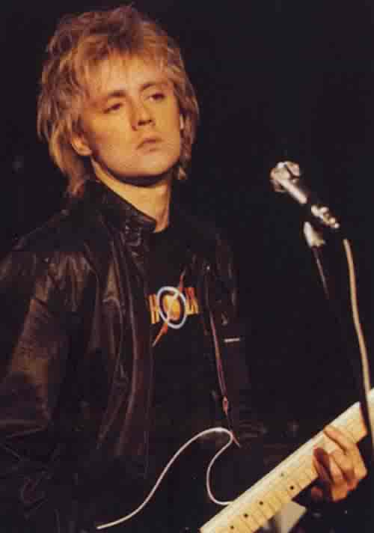
NEWSFLASH! Roger is Flash Gordon!
………
He’s mental, he’s albino-y, he’s blonde, he’s plastic-y looking (sometimes), and he’s wearing a Flash Gordon t-shirt!

Slide 30
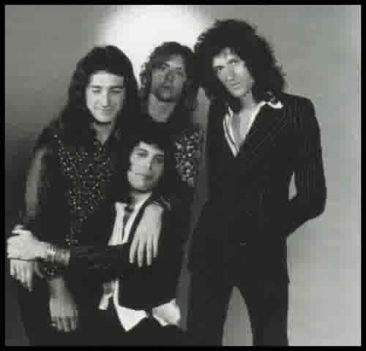
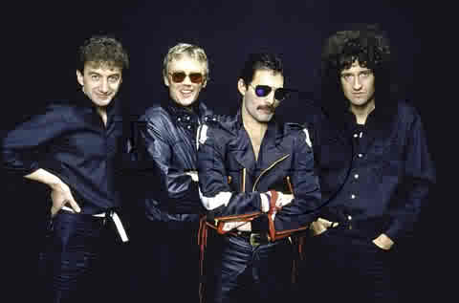
John’s dreaming about having more kids. Just kidding. He’s dreaming about cookies. Good cookies. UBERCOOKIES.
Roger finds the dark side amusing.

Slide 31
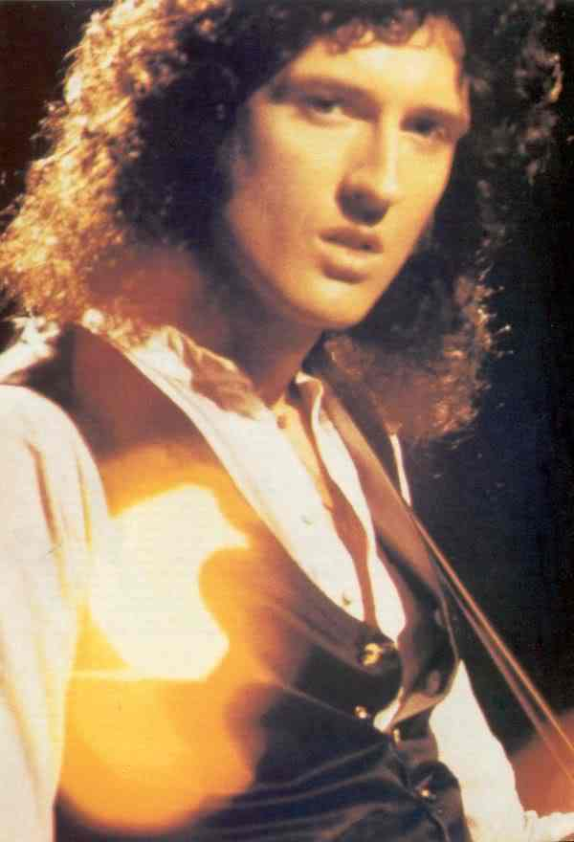
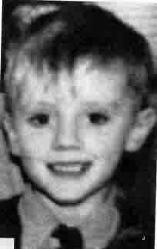
Brian has a heart full of sunshine. However, his heart seems to be in a very odd place.
Roger looks like a fetus (or Rufus)
…now he’s an evil fetus-child

Slide 32
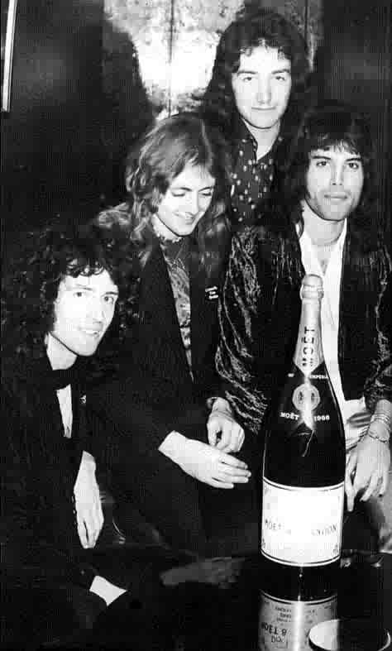
Roger can’t believe what he’s seeing! Someone’s breaking all the vodka bottles! (he’s in the middle, by the way)
We all know what Roger’s staring at and why.
Oh
my
God!

Slide 33
What will you be doing when your diarrhea medicine stops working?
Camera fail.

Slide 34
ROGER FAIL.
OMG! Roger’s legs are so skinny, they’re invisible! *The Invisible legs*

Slide 35
Roger’s sitting on the Invisible Man!
The Invisible Man will get revenge. Oh yes, he will get his revenge…

Slide 36
HANDSHAKE FAIL.

Slide 37
Now for a tard moment staring: Bri Har May & Rog Med Tay! (1982 Bri & Rog)
You quit because you didn’t like all the blood, though. Then you went into biology. So, you’re dumb.
For some odd reason
I’m done with this too.
Roger, you’re dumb.
You’re still dumb. But, you’re not as dumb as Paul Rodgers.
Hey… that’s my thing! I’m the suicidal one!
At least I won’t later marry a Frenchie.
Hey, that’s my line!
I have to disagree. I was in dentistry.
Not anymore.
WHAT’S GOING ON!
I’m done with this.
Not anymore.
Yeah, well I’m the one that everybody likes!
If I was, I think I’d kill myself.
At least I graduated!
At least I won’t marry an Anita!
Hey! That’s my line!
That’s not funny.

Slide 38
I’m a creepy lumberjack, and I’m okay!
* They are looking in a mirror right now. Except for John.
WTF!?
WTF!?
WTF!?
Tard moment # whatever

Slide 39
It’s Queen, and the Leprechaun!

Slide 40
Who’s awesomer?
The Beatles
Queen
Answer: The Beatles.
Not!
Queen.
VS

Slide 41
Queen was, and still is, one of the greatest bands. Ever. They have sold more albums than anybody– including the Beatles – in the UK, and have toured almost everywhere in the world. They are one of the few bands to stay together for as long as they have, and one of the few bands to have at least one music legend in it. Plus, I think they have more “Pictures With Comments” PowerPoint's than any other band there is. I don’t know what you think, but I think Queen is incredibly über… and a bit mental as well. Which, don’t get me wrong, is a good thing. If they weren’t, “Pictures With Comments wouldn’t exist! (Or, if it still did, wouldn’t be nearly as funny.)

