Slide 1
Photoshop Pictures (in order of placement)
Julia

Slide 2
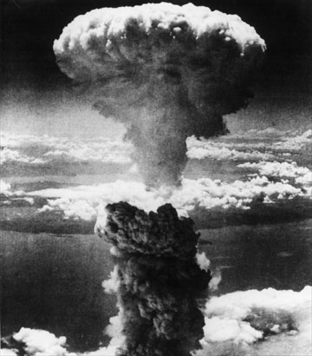
The background

Slide 3
Part of the album name

Slide 4
The other part of the album name

Slide 5
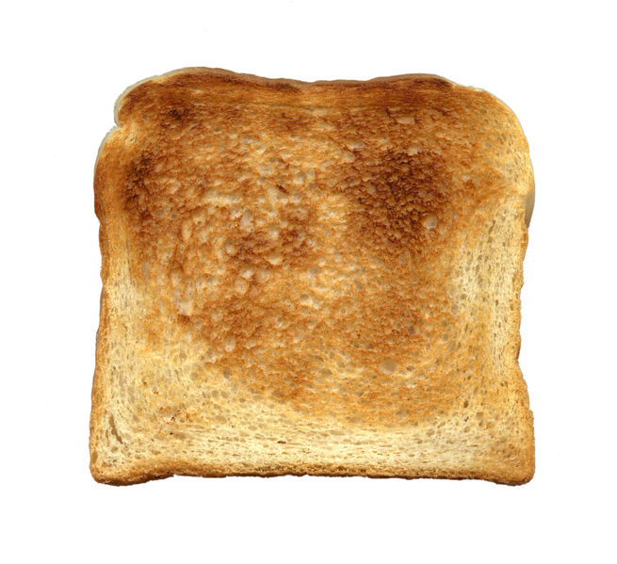
Lead singer toast

Slide 6
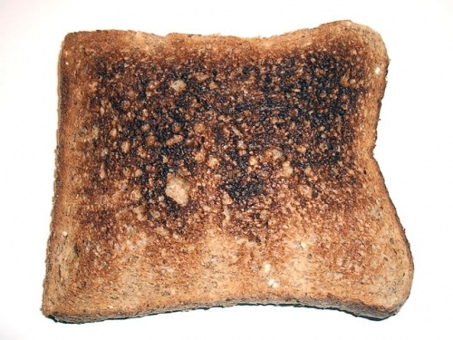
Guitar toast

Slide 7
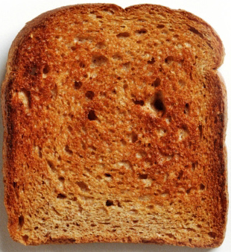
Bass toast

Slide 8
Microphone

Slide 9
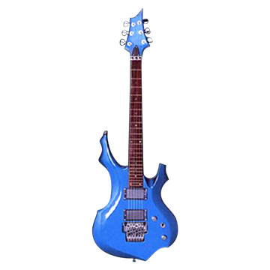
Toast’s guitar

Slide 10
The bass of Toast

Slide 11
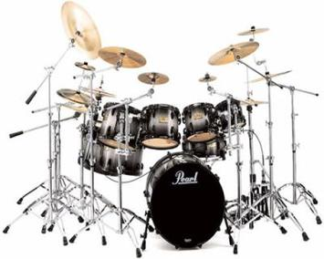
Drums

Slide 12
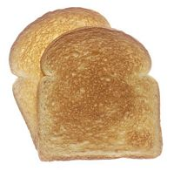
Drummer toast (the one in front)

Slide 13
The words at the top of the album

Slide 14
‘Hit single’ thing along the bottom

Slide 15
This is the rock band, Toast. It consists of Jimmy the guitar toast, Robert the bass toast, Rufus the drummer toast, and Popcorn James, the lead singer toast.

